Slide 1
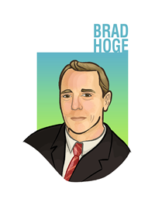
Turning Misinformation into Educational Opportunities
Dr. Brad Hoge – Director of Teacher Support
National Center for Science Education

Slide 2
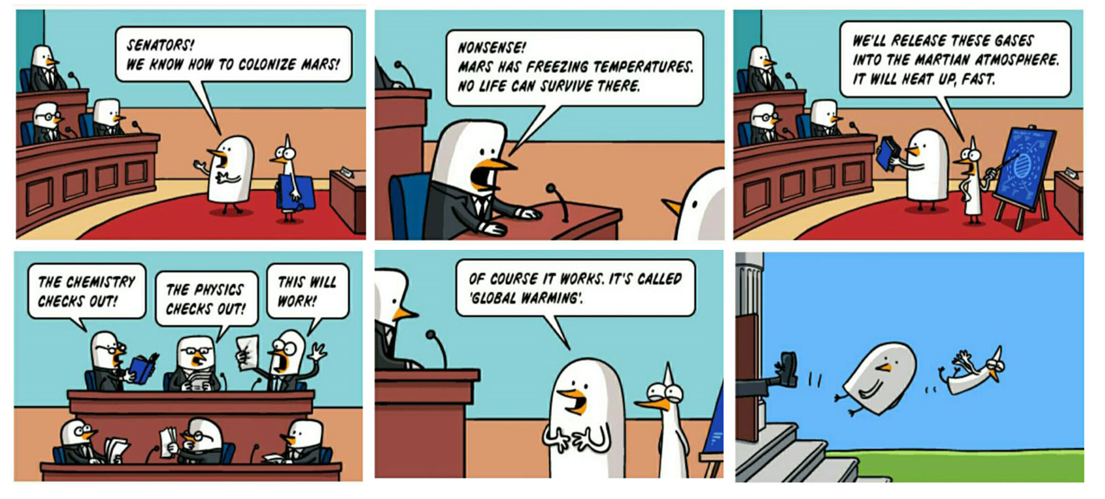
Cartoon from lolsnaps.com

Slide 3
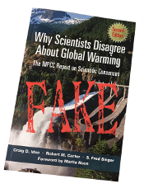
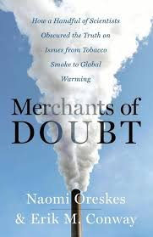
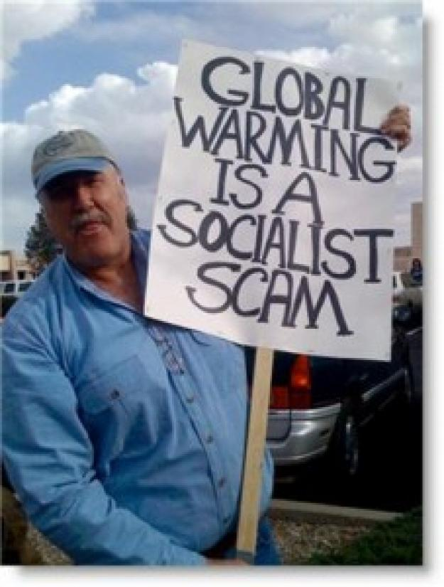
Why is there so much controversy about climate change?
Merchants of Doubt
Peddlers of Propaganda
Sowers if Discord
“Laypeople frequently assume that in a political dispute the truth must lie somewhere in the middle, and they are often right. In a scientific dispute, though, such an assumption is usually wrong.”
- Paul Ehrlich (Speaking about climate change)

Slide 4
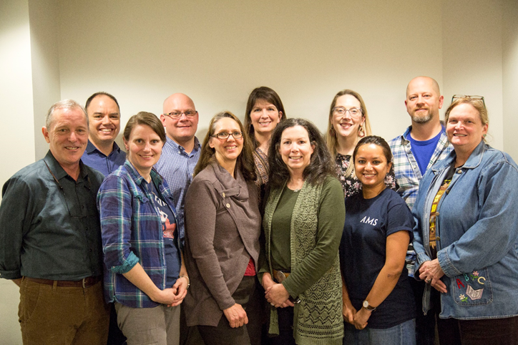
Turning Misinformation into Educational Opportunities
Why data-driven and place-based PBL works so well for teaching about climate change
TMEO resources
NCSEteach
NOAA CLEAN Lesson Database
NOAA Planet Stewards
GMU C4
ACE
How misconception-based teaching works
TMEO’s ulterior motives

Slide 5
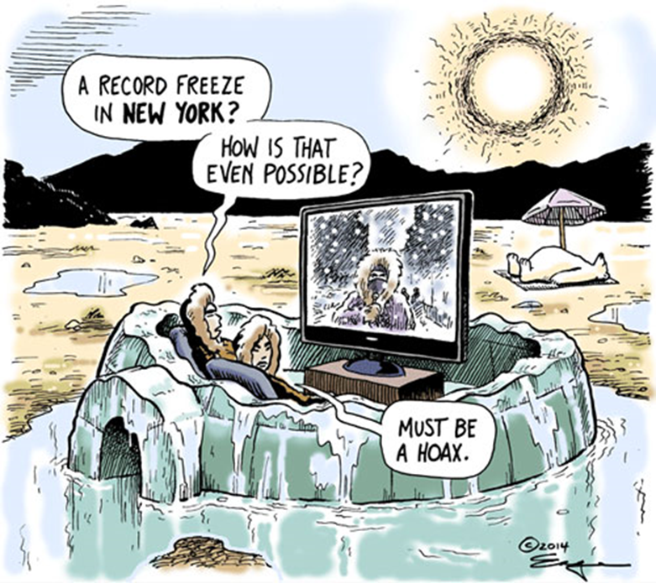
Barriers
Cognitive barriers (evolutionary psychology)
Probability
Proximity
Deep time
Familiarity
Ideological barriers
Affiliation with groups (social / historical)
Affiliation with ratiocination (social / logical)
Cultural and religious barriers
Cartoon by Tim Eagan

Slide 6
Public Perceptions
Attitudes toward science are not uniformly associated with one particular demographic group but instead vary based on the specific science issue.
Recent research suggests that underlying factors, such as group identity, can strongly influence perceptions about science.
A person’s knowledge of science facts and research is not necessarily predictive of acceptance of the scientific consensus on a particular question. Indeed, for certain subgroups and for certain topics such as climate change, higher levels of science knowledge may even be associated with more-polarized views.

Slide 7
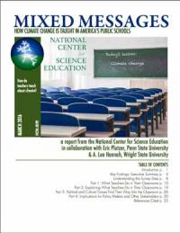
Teacher’s Perceptions
Climate change is taught inconsistently in U.S. public schools.
In most communities, teachers have not been required to teach the subject and have been provided neither the training, nor the curricular resources to do so.
NCSE’s own teacher survey conducted in 2016 revealed that only about half of all science teachers are aware that the science is settled and not appropriate for debate.
Furthermore, the political polarization around the topic means that many teachers work in communities where climate change is not widely accepted so that they have a reasonable fear that covering the topic will lead to conflict.

Slide 8
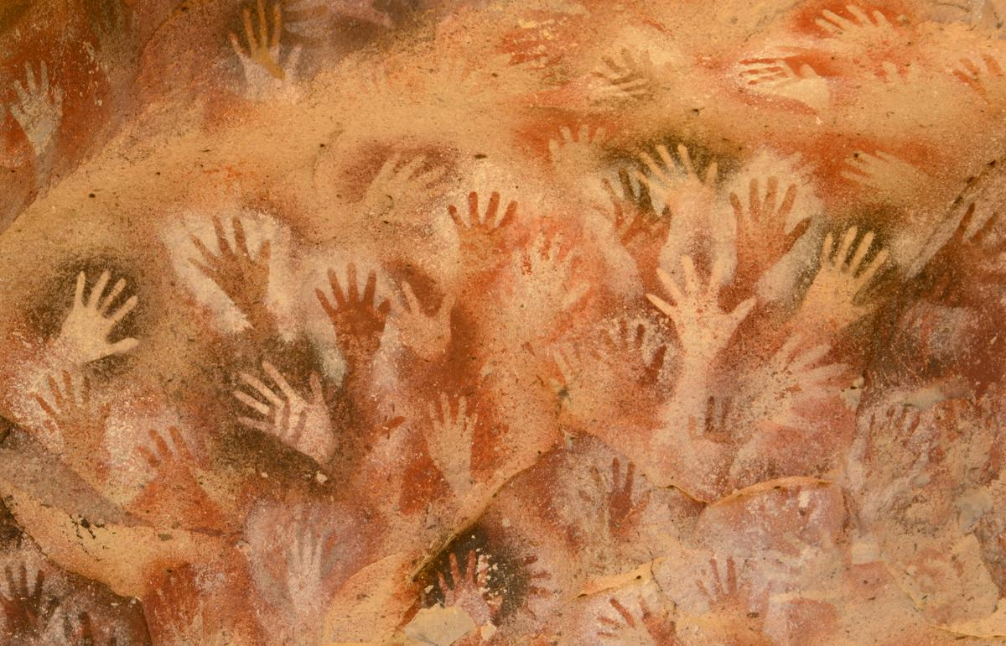
Teaching Science
Constructivism
Hands-on
Data-driven
Place-based
Real-world
PBL
Project-based
Problem-base
Game-based
Research-based
Photo from Wikimedia

Slide 9
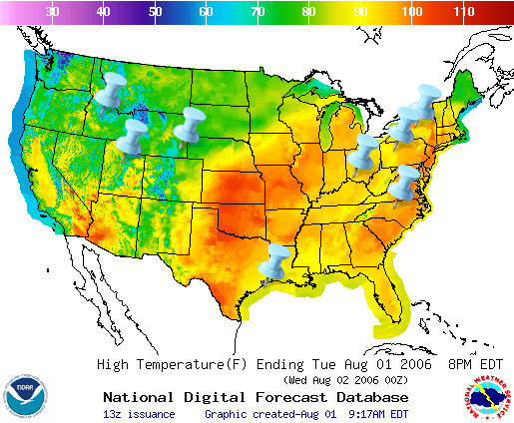
NCSE Ambassador Teachers
David Amidon – Syracuse, NY
Bonnie Bourgeous – Salt Lake City, UT
Jennifer Broo – Cincinnati, OH
Nina Corley – Galveston, TX
Alexander Dorsch – New Castle, PA
Kim Parfitt – Cheyenne, WY
Kelly Pipes – Wilkesboro, NC
Erin Stutzman – Boise, ID

Slide 10
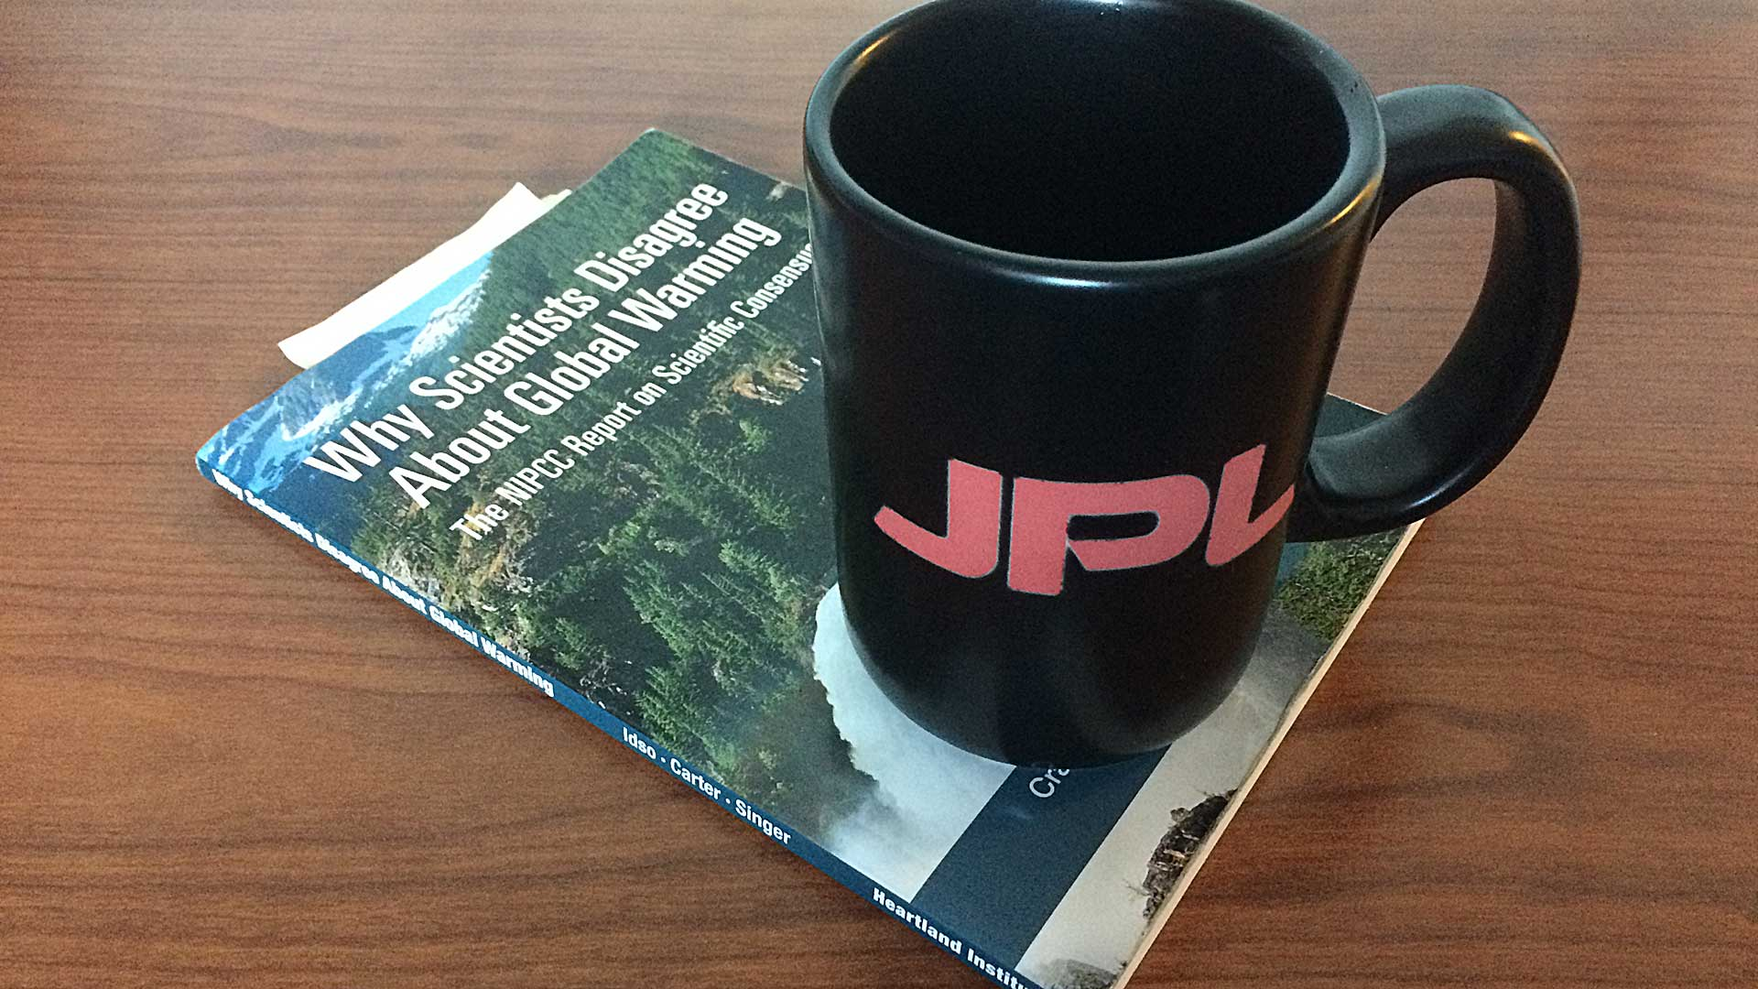
Scientists don’t agree
Models aren’t good science
It’s just a natural process, climate has always changed
Extreme weather happens, it’s not climate change
There’s nothing we can do about it

Slide 11
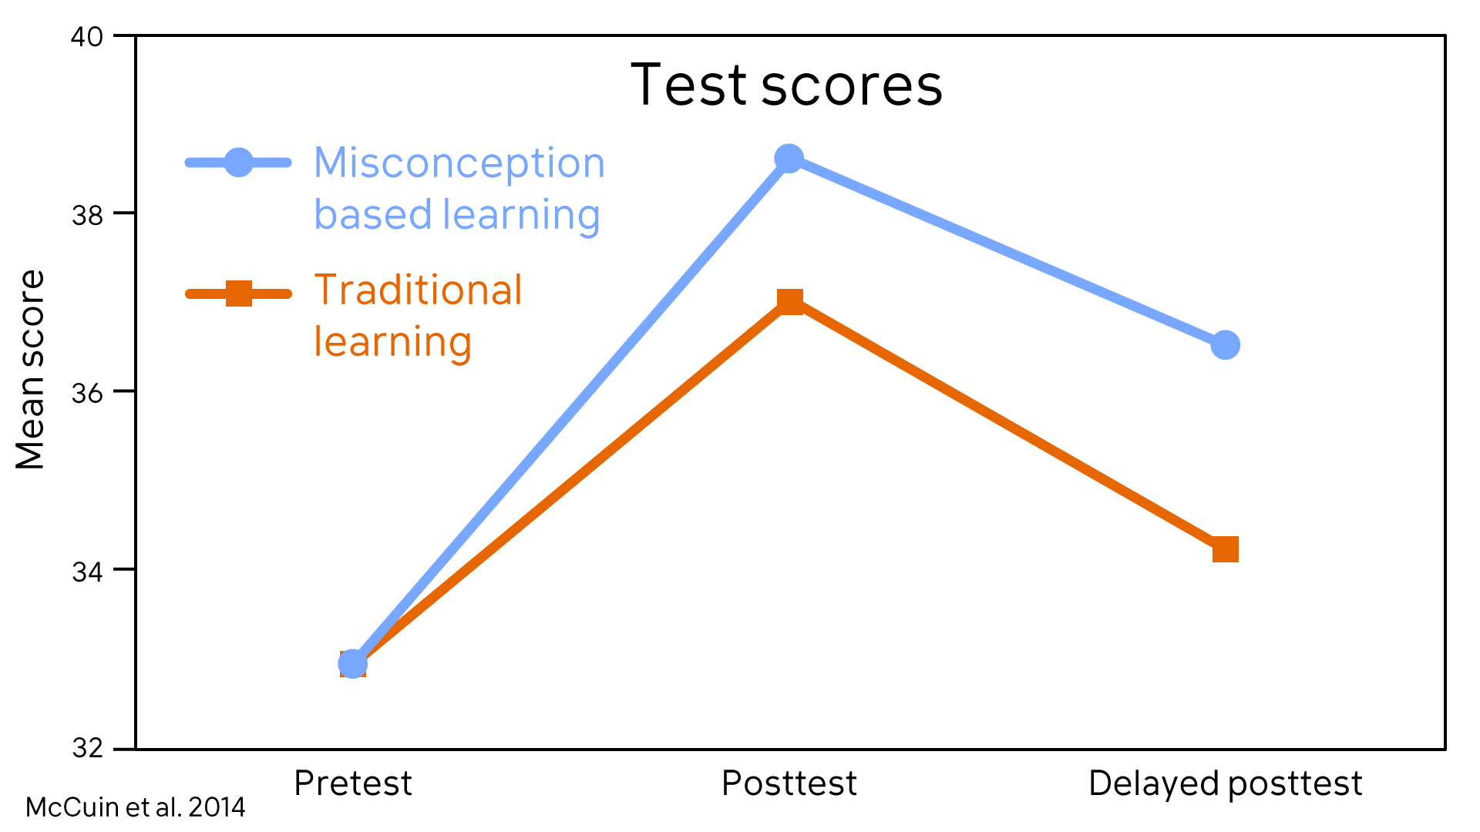
Misconception-based learning

Slide 12
Fact-myth-fallacy structure

Slide 13
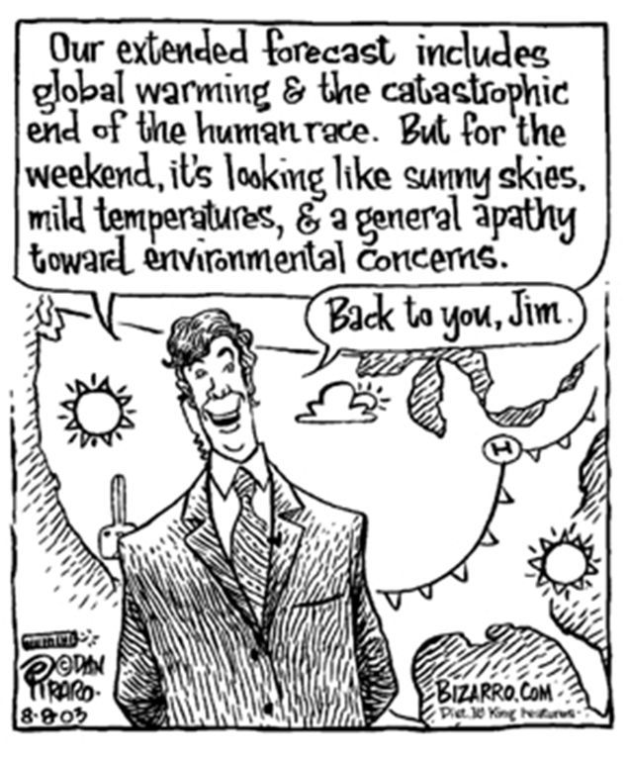
The 5 TMEO Lessons
Lesson #1 – The Scientific Consensus on Climate Change
Lesson #2 – Modelling
Lesson #3 – Past Climate Change
Lesson #4 – Local Impacts
Lesson #5 – Solutions
I’m going to walk you through all 5 lessons, and we’ll do hands-on portions of #s 1, 4, and 5

Slide 14
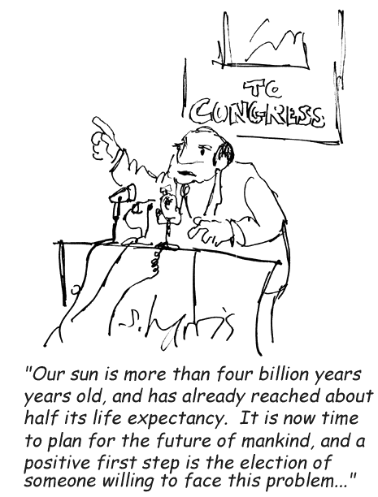
Lesson 1 – Teaching Consensus
This lesson is a bit different than the rest
This lesson sets the table for the rest of the unit
The learning objectives for this lesson focus on skills – particularly inoculation against misinformation
Closing the lesson with FLICC provides an opportunity for assessment
Let’s walk through the lesson
Cartoon by Sydney Harris

Slide 15
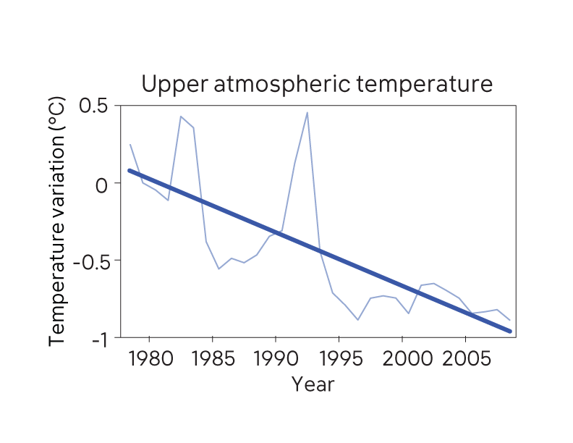
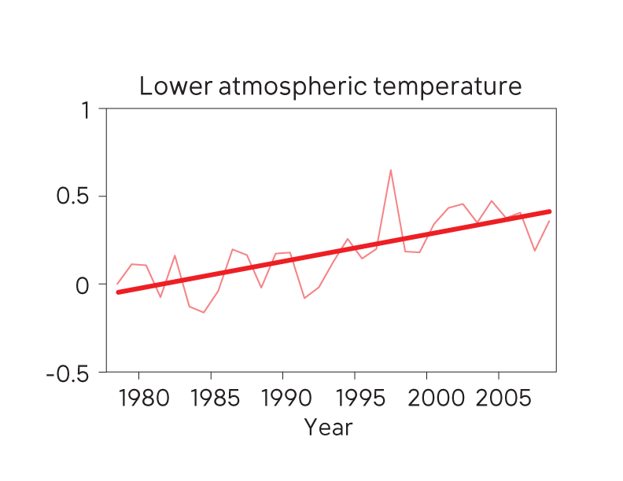
Focus on Data

Slide 16
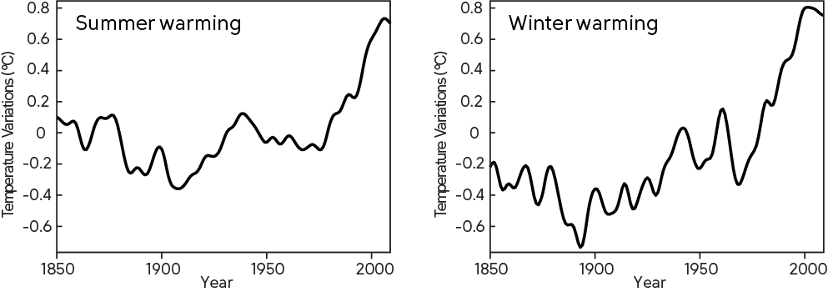
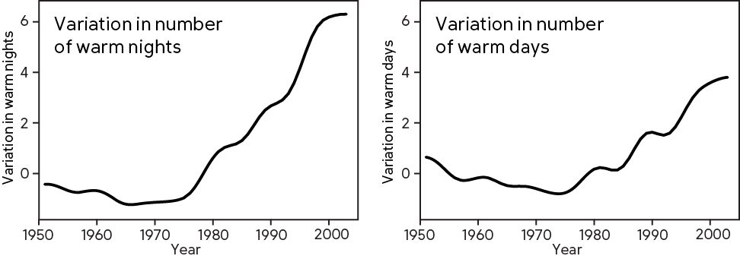

Slide 17
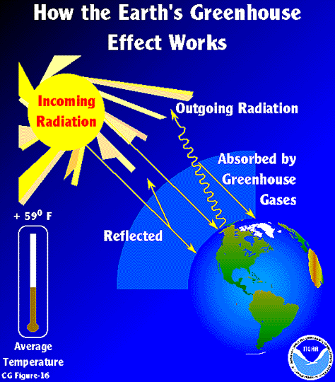
Be a Guide on the Side
Possible questions to ask your students:
How can the sun impact Earth’s average global temperature?
How can Greenhouse Gases impact Earth’s average global temperature?
Why is the troposphere warmer than the stratosphere?
Why does each layer cool at night?
Why are summer days and nights warmer than winter days and nights?
Do you think the stratosphere has seasonal variations too?
What happens where the troposphere and stratosphere meet?
Why are the layers so distinct?
https://www.esrl.noaa.gov/gmd/outreach/
lesson_plans/images/CG_Figure_16.gif

Slide 19
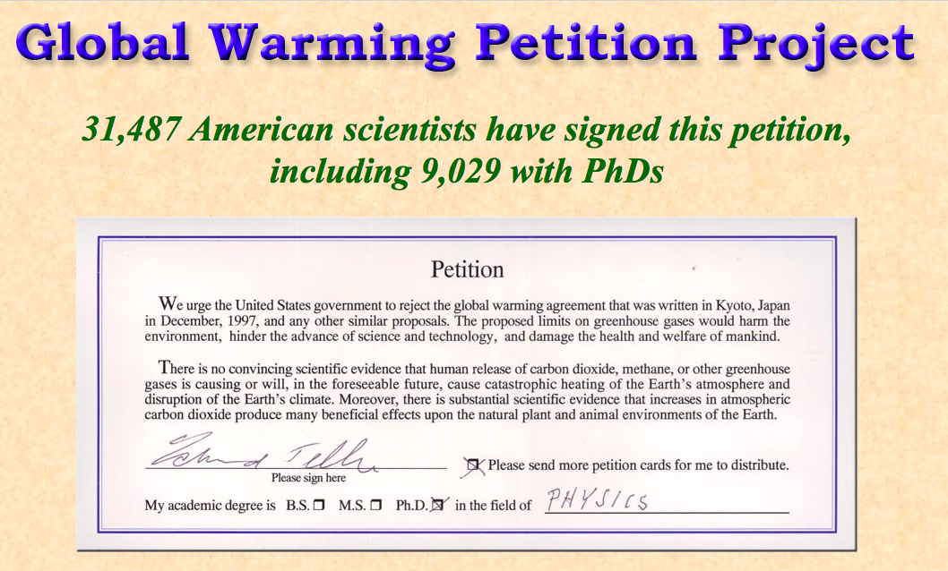
Assess Using FLICC
FACT
Based on independent lines of evidence, a scientific consensus has formed that humans are causing global warming.
MYTH
31,000 dissenting scientists prove there’s no scientific consensus agreement on human-caused global warming.
FALLACY
Fake experts: people who convey the impression of expertise but with no relevant expertise are often used to cast doubt on expert consensus.

Slide 20
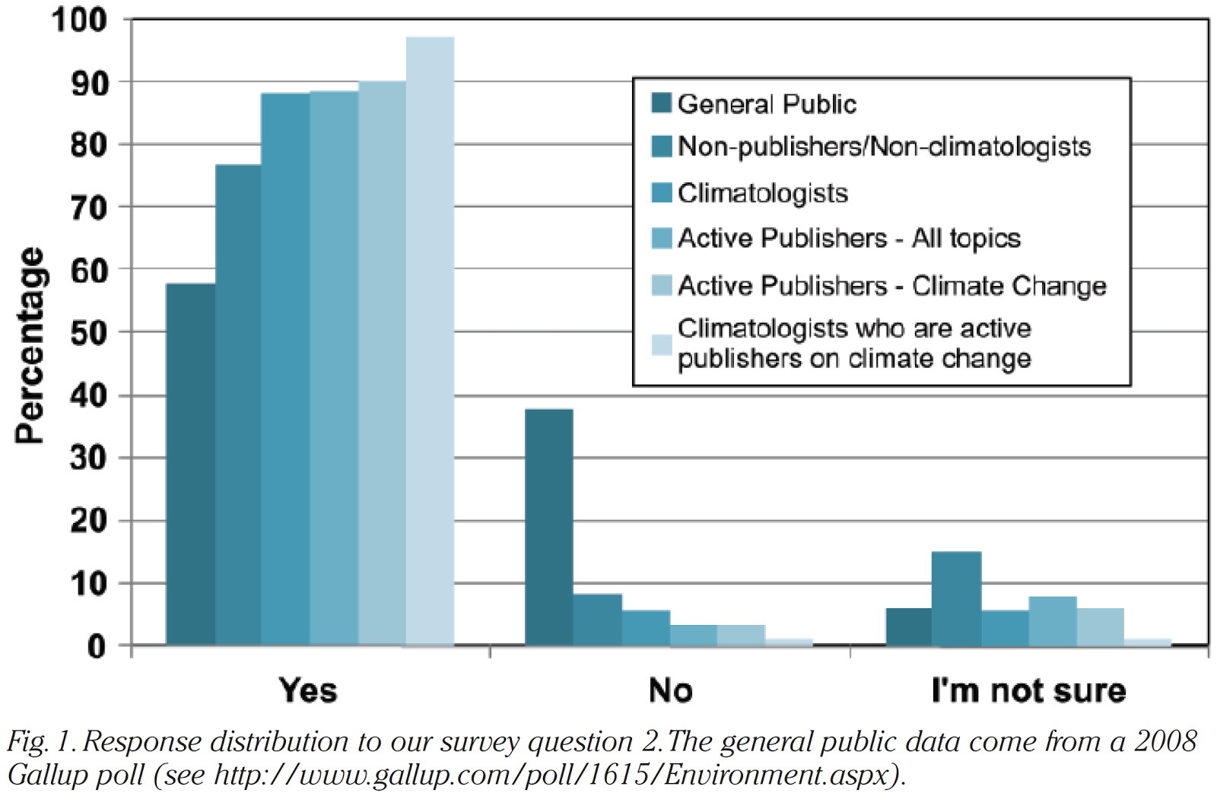

Slide 21
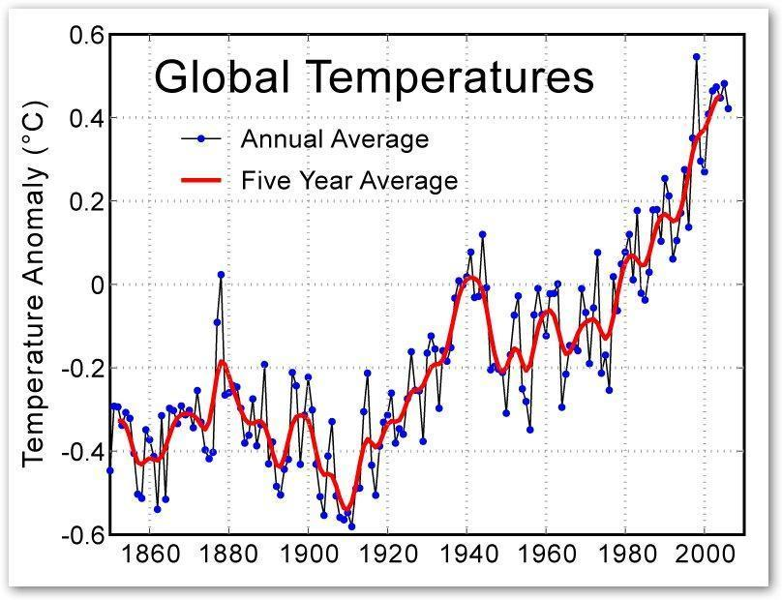
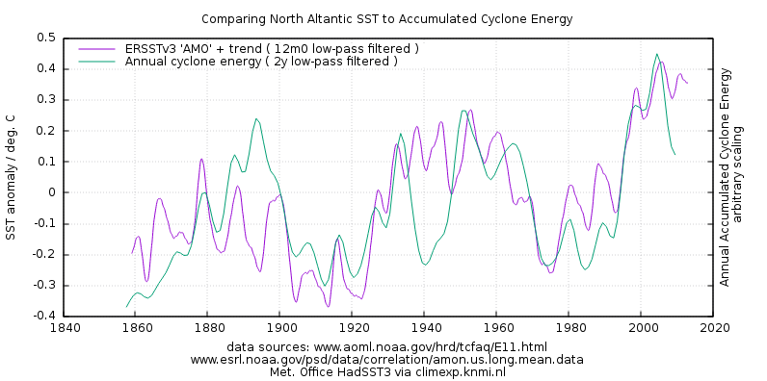
Alternative Applications
Other data sets such as the global temperature curve can be used for younger students
More advanced students can dig deeper into the actual data and generate the curves themselves
It may not be possible to save the misconception till the end for advanced classes, so flip it or use TBL
The lesson can also be extended over 2-3 class periods to spend more time with each activity

Slide 22
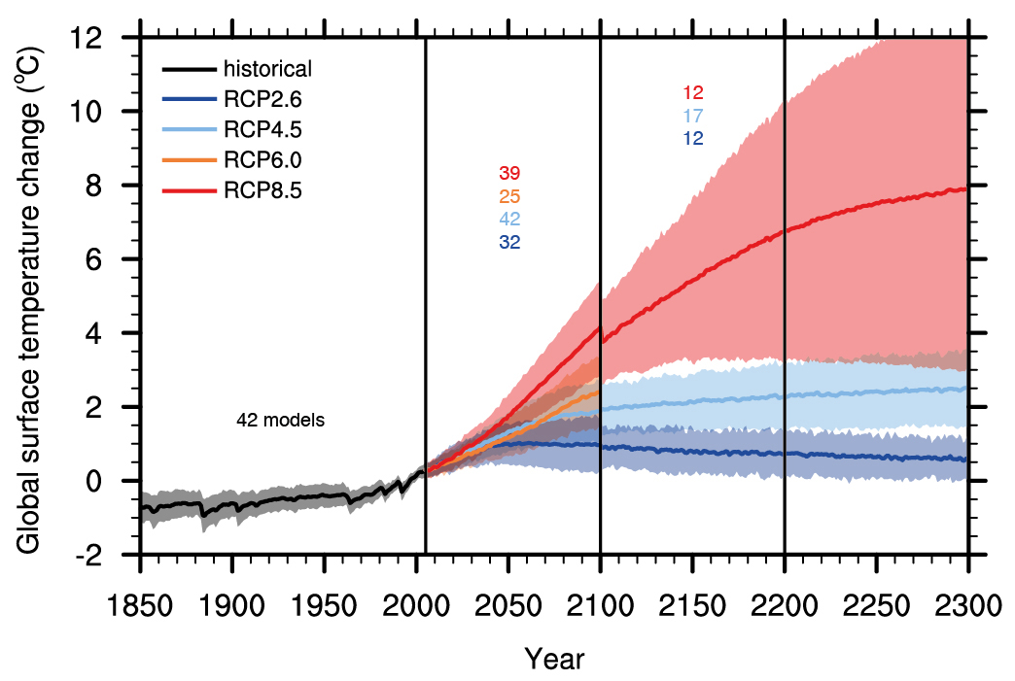
Lesson 2 - Modelling
Two approaches
Predict a trend and build a model to help from the demands of the prediction
Identify components of the climate system and arrange them into a
2-dimensional model

Slide 23
Predicting the Future
Predict the trend shown to the year 2017

Slide 24
Compare to Actual Data
How accurate was your prediction?
Now predict the trend to the year 2030, 2050, and 2100.

Slide 25
Lesson 2: Climate models
FACT
Climate models have made many successful predictions of long-term warming and specific climate patterns. While there are parts of climate that are challenging to simulate, such as short-term predictions, models are continually being improved to introduce more detailed physical processes.
MYTH
Model predictions have failed in the past, therefore models can’t be trusted.
FALLACY
Impossible Expectations: No model is perfect but they are useful tools that can reproduce the past and provide insights into the future.

Slide 26
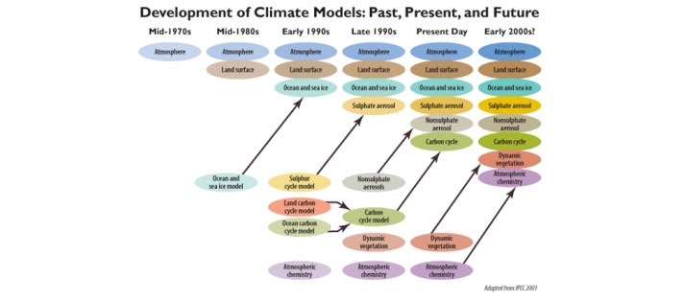
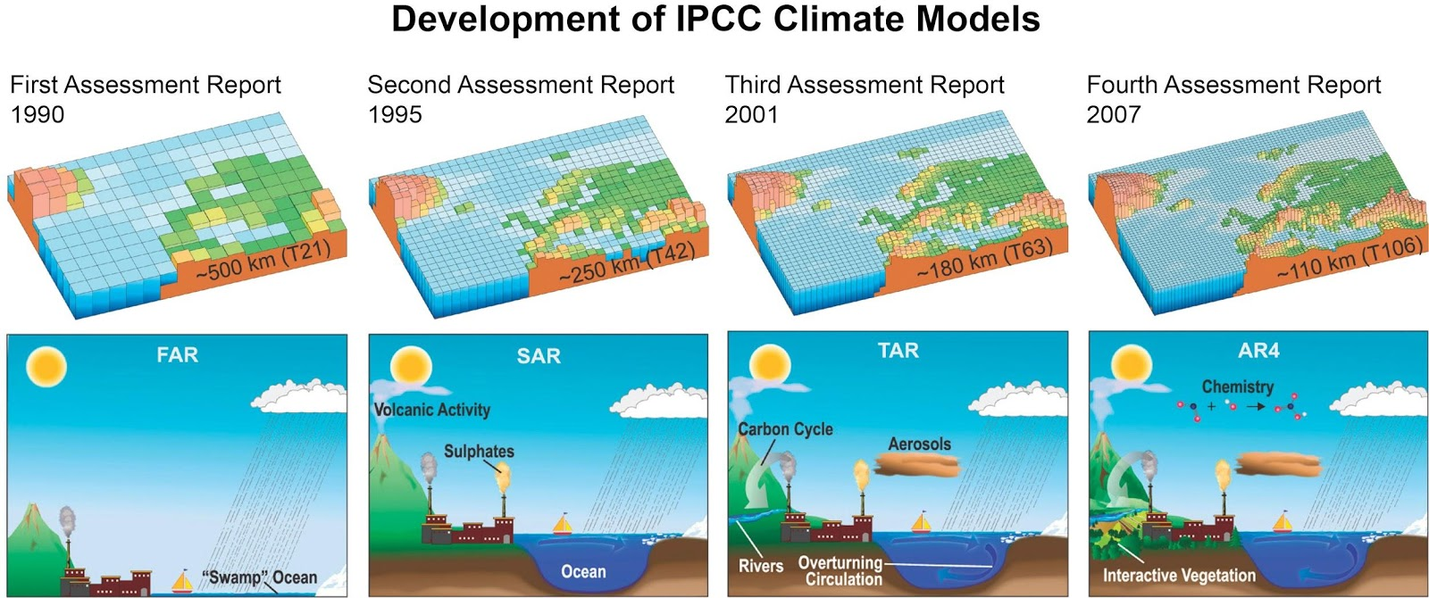

Slide 27
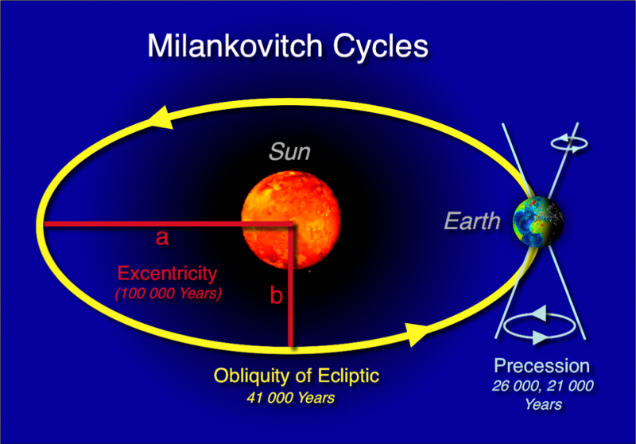
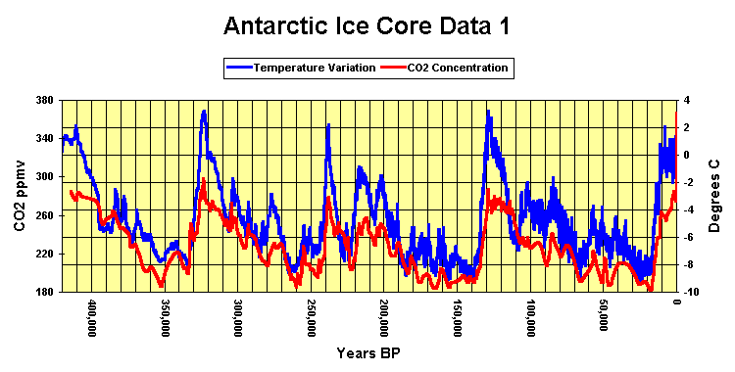
Lesson 3 – Past and Present
Putting anthropocentric climate change in perspective
Milankovitch cycles and ice core records
Comparing past climate change to current climate change

Slide 28
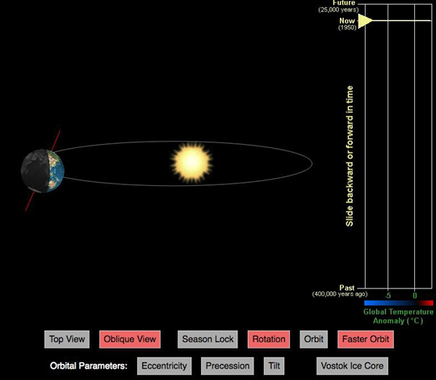
https://cimss.ssec.wisc.edu/wxfest/Milankovitch/earthorbit.html

Slide 29
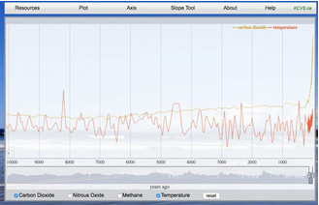
http://www.kcvs.ca/site/projects/JS_files/HistoricClimateChange/
history.html

Slide 30
Lesson 3: Past climate change
FACT
Modern climate change is abrupt and driven by human activity, distinguishing it from past climate change.
MYTH
Natural climate change in the past implies current climate change is also natural.
FALLACY
Jumping to conclusions: Just because climate change was caused by natural causes in the past doesn’t necessarily mean it’s naturally caused now.

Slide 31
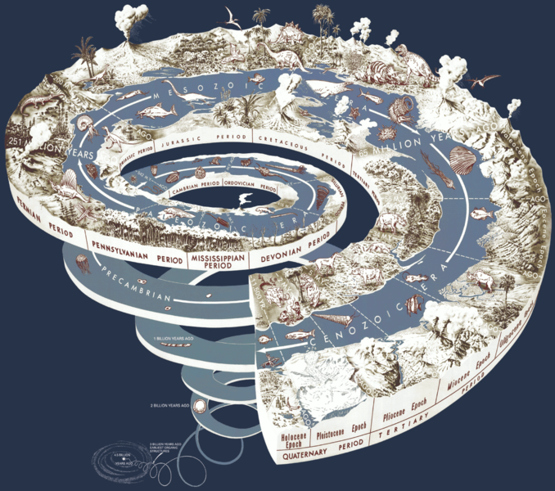
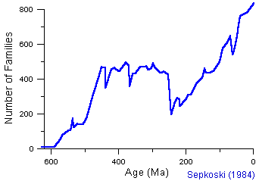
Alternative Applications
Younger age groups can engage with more hands-on data such as tree rings.
More advanced groups can use different data sets such as sediment cores.
It may also be helpful to look at different time frames to put the comparison into perspective:
Biological Time / Ecological Time / Geologic Time
Mass Extinction Events

Slide 32
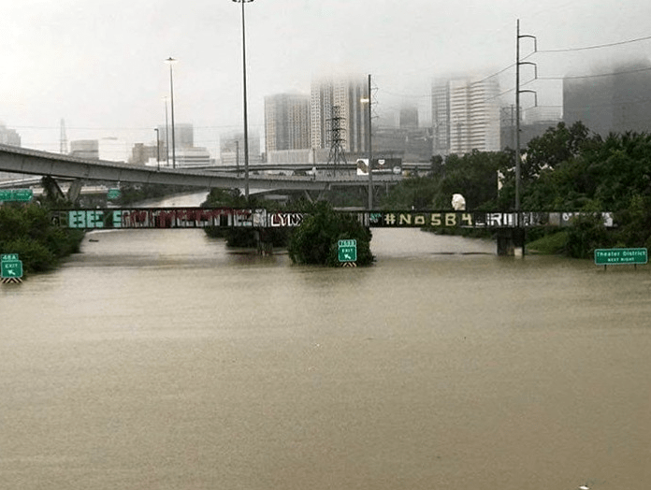
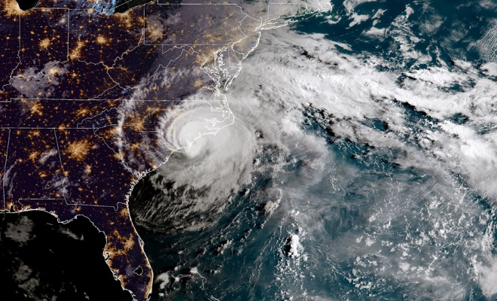
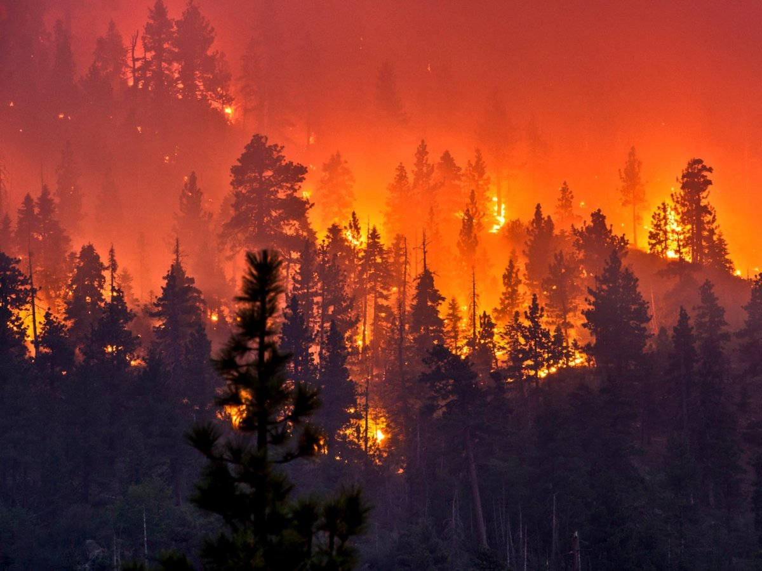
Lesson 4 – Extreme Weather
What is the connection between extreme weather and climate?
What are extreme weather events/conditions in your area?
How can you turn this into a lesson for your class?

Slide 33
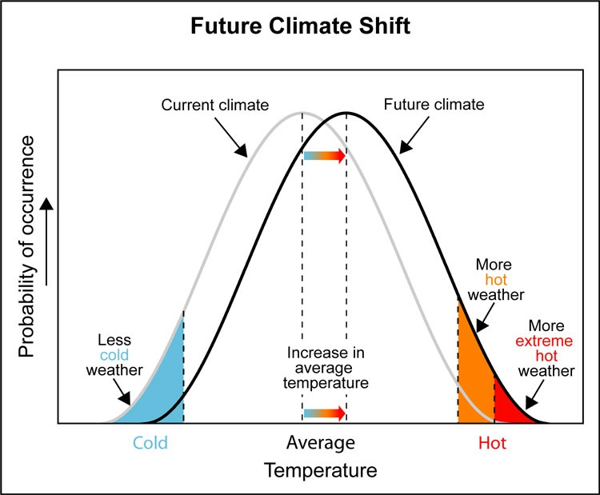
Science of Extreme Weather

Slide 34
Steroids, Baseball, and Climate Change
Red & blue die for each student
Blue numbered as 1-2-3-4-5-6
Red numbered as 2-3-4-5-6-6
(Or have 1 represent 6 on red dice)
Blue represents “normal” conditions prior to human impacts
Red represents impact of climate change
Roll the dice
Blue Dice
1 - EXTREME cold
2 - cold
3 – seasonally “normal”
4 – seasonally “normal”
5 - hot
6 - EXTREME hot
Red Dice
2 - EXTREME cold
3 - cold
4 – seasonally “normal”
5 - hot
6 - EXTREME hot
6 - EXTREME hot

Slide 35
https://crt-climate-explorer.nemac.org

Slide 36
Lesson 4: Extreme weather
FACT
Risk from extreme weather is increasing, albeit some forms of extreme weather are more confidently linked to global warming than others.
MYTH
Extreme weather always happens, so warming isn’t making extreme weather worse.
FALLACY
Jumping to conclusions: Just because extreme weather happened in the past doesn’t mean climate change isn’t having an influence now.

Slide 37
Examples from NCSE Teacher Ambassadors
David Amidon – Lake effect snow in upstate New York
Bonnie Bourgeous – Snow melt and drought in Salt Lake City, UT
Nina Corley – Flooding on Galveston Island, TX
Kim Parfitt – Wildfires in Wyoming
Erin Stutzman – Snow melt, wildfires and insect infestation in Idaho

Slide 38
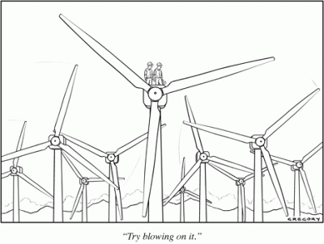
Lesson 5 – Solutions
We can make a difference
At the individual level
At the community level
At the global level
What is the wedge stabilization strategy game?
What are the unique opportunities in your area?
Cartoon by Alex Gregory

Slide 39
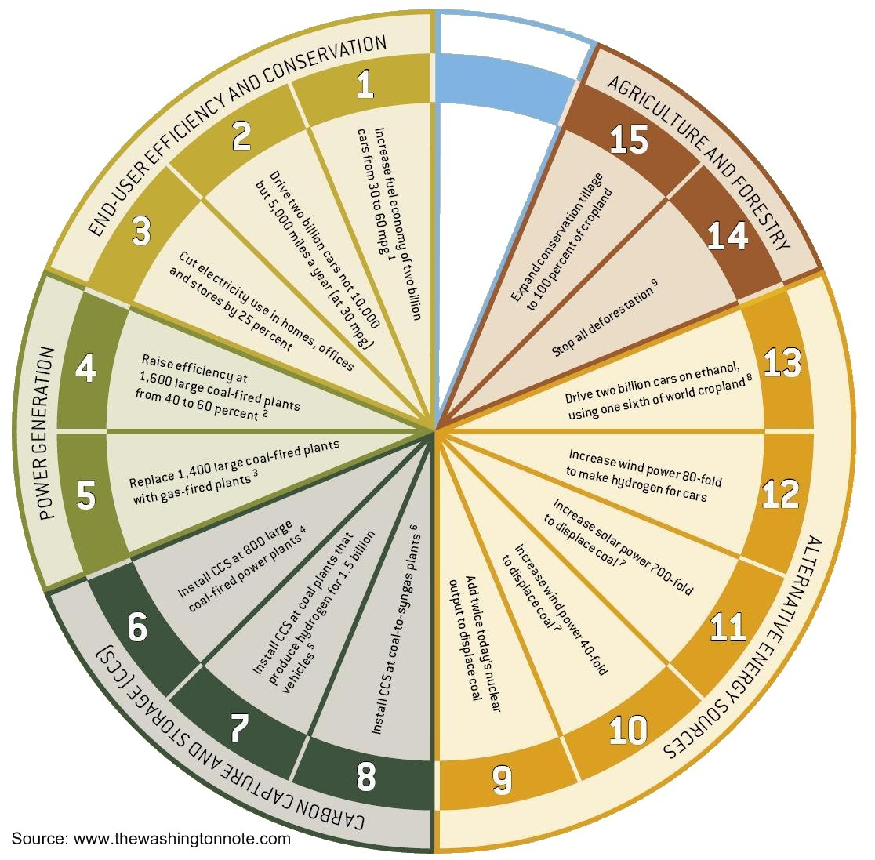
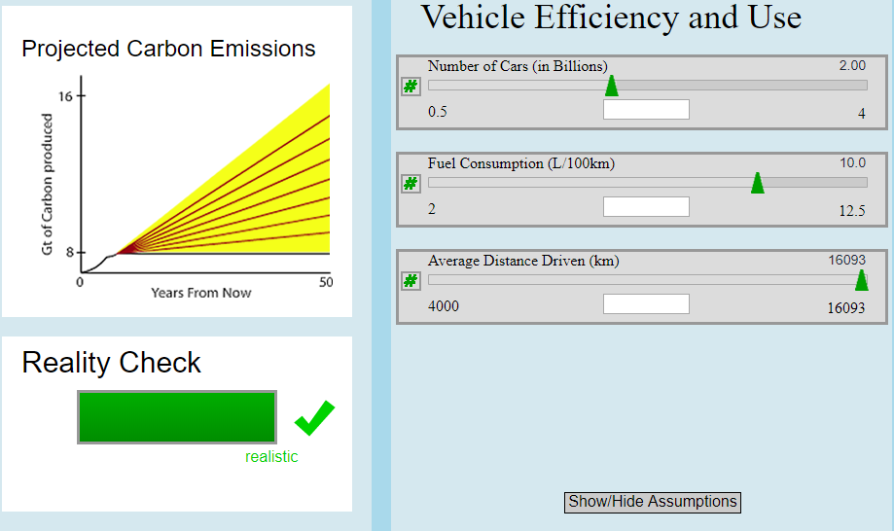
http://kcvs.ca/site/projects/JS_files/Stabilization_Wedges/stabilizationWedges.html

Slide 40
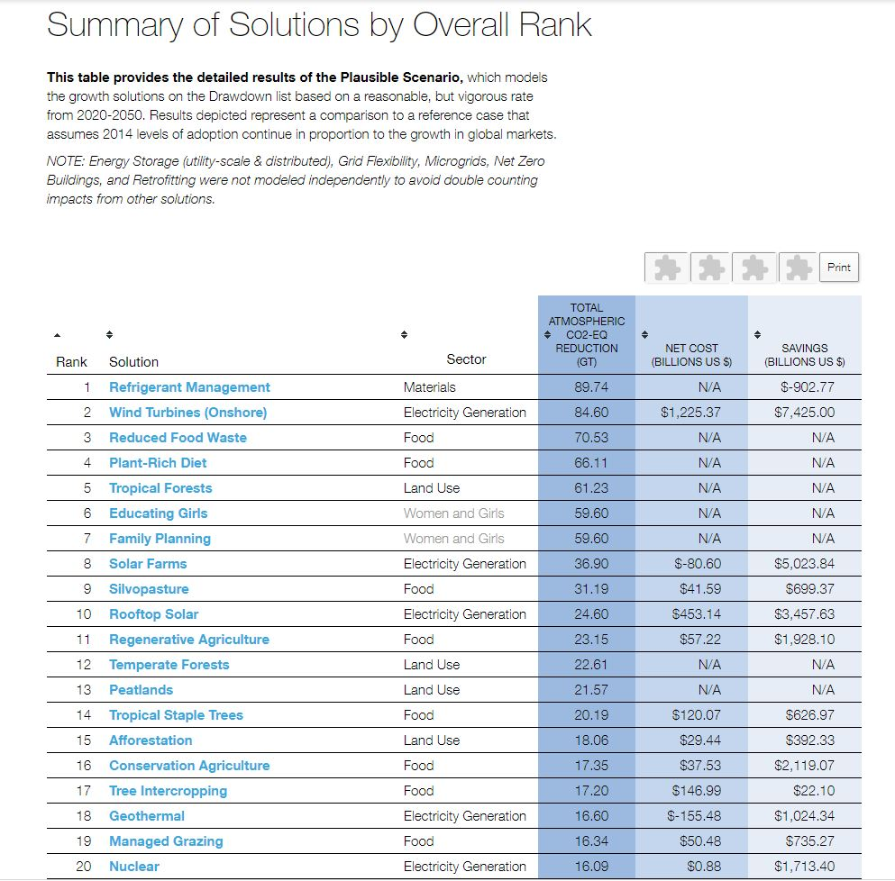
Project Drawdown
https://www.drawdown.org/
solutions-summary-by-rank

Slide 41
Lesson 5: Climate solutions
FACT
There are multiple strategies to reducing carbon emissions, and there are realistic paths to preventing climate change if we try many solutions at once.
MYTH
Renewables like solar or wind are not enough to solve climate change.
FALLACY
Cherry picking: focusing on just one or a few possible solutions ignores that solving climate requires a multi-pronged strategy.

Slide 42
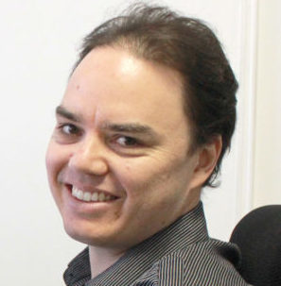

Slide 43
TMEO Lessons
https://ncse.com/teach/sandbox
Shared Google Drive Folder at https://drive.google.com/open?id=1CYJtr91pZHBHyaqjKXjCdt_-B235Zcbq (or e-mail me for the links ☺)
ACE Recorded Webinars at https://vimeo.com/acespace

Slide 44
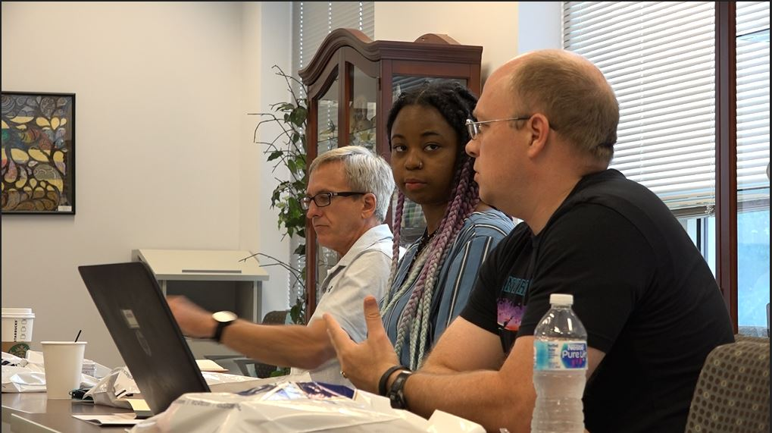
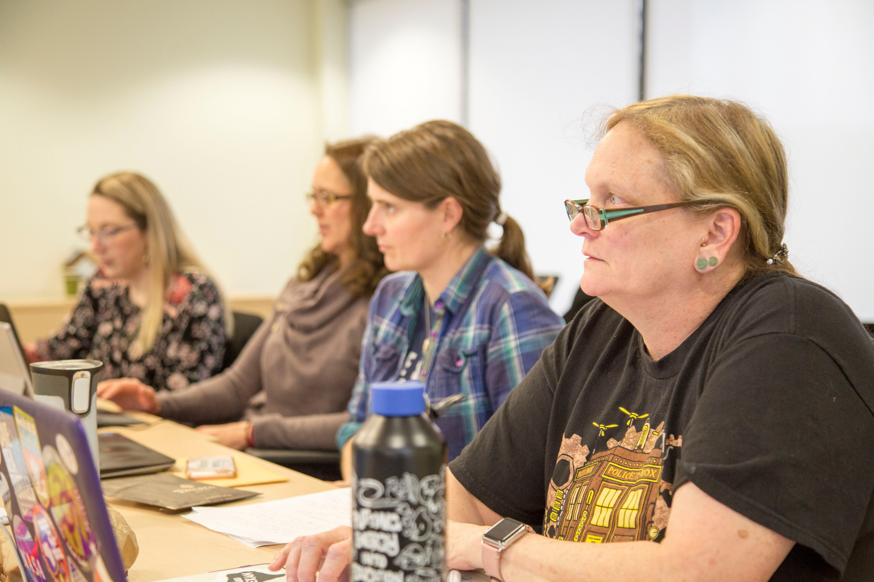
Upcoming NCSE TAP Workshops
Second TMEO Workshop for new Teacher Ambassadors
March 1st – 2nd 2019
Apply here
Nature of Science Workshop at Clemson University
TBA
Ongoing workshop development by existing Teacher Ambassadors
Subscribe to the NCSEteach Newsletter to stay up to date

Slide 46
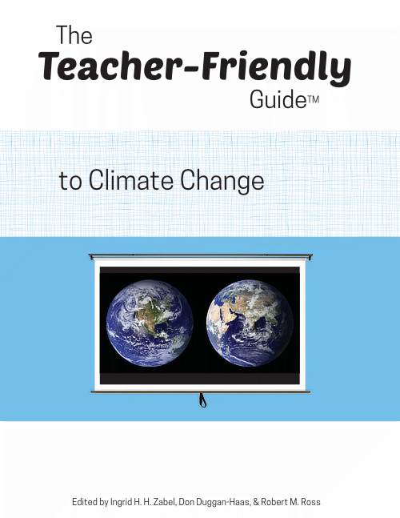
Resources

Slide 47
Contact me
Brad Hoge
hoge@ncse.com
(510) 601-7203 ext. 315
NCSE.com/teach
Teacher Newsletter
Classroom Resources
Dealing with Denial

