Slide 1
NCSE Webinar: Media skills for science education advocates
Robert Luhn
Director of Communications
National Center for Science Education, Inc.
luhn@ncse.com

Slide 2
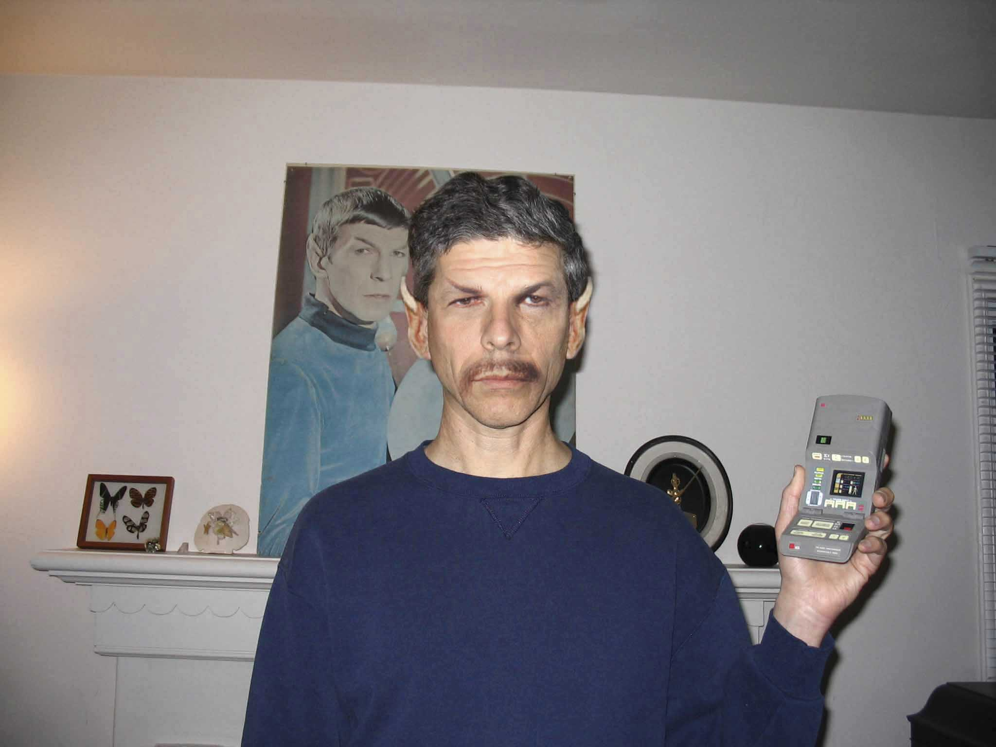
What I Do: Press Relations

Slide 3
What I Do: Social media

Slide 4
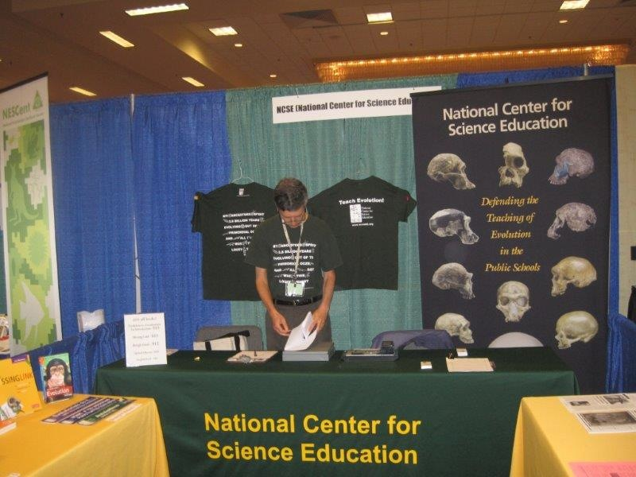
What I Do: Events/Promotions

Slide 5
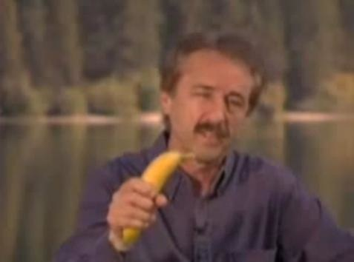
Case Study: Ray Comfort

Slide 6
Case Study: Ray Comfort

Slide 7
Develop Talking Points

Slide 8
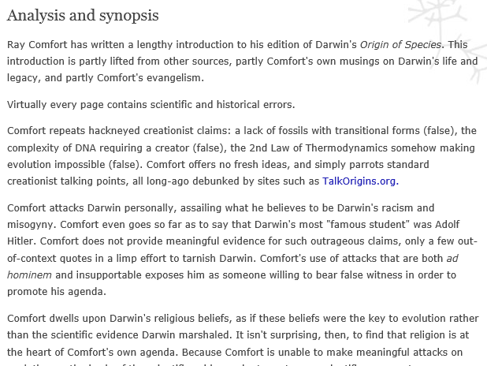
Develop detailed, blow-by-blow analysis

Slide 9
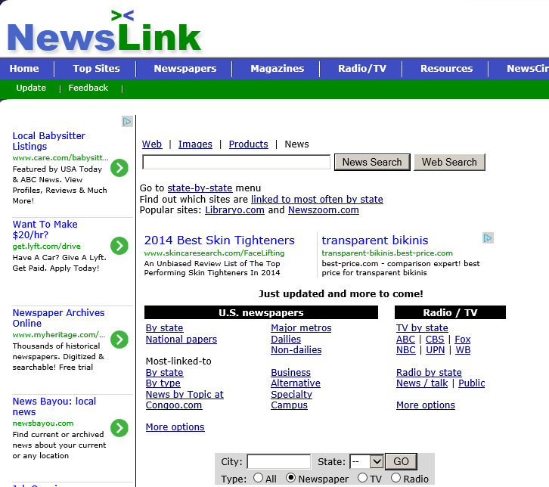
Develop Contact List

Slide 10
Create Dedicated Website

Slide 11
Humor sells

Slide 12
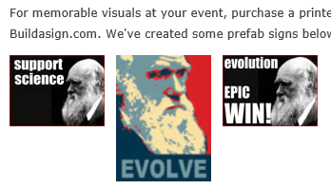
Humor sells: Protest signs

Slide 13
Humor sells: NCSE Safety Bookmark

Slide 14
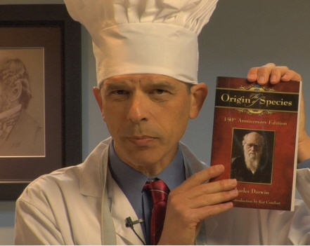
Humor sells: Faux PSA

Slide 15
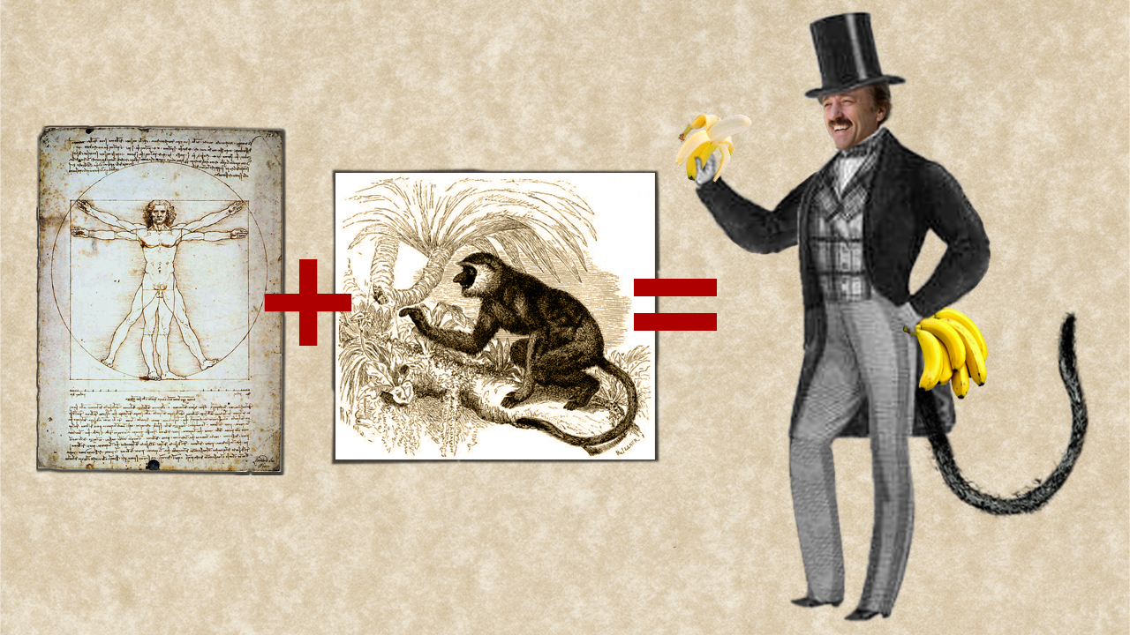
Humor sells: Graphics and Animation

Slide 16
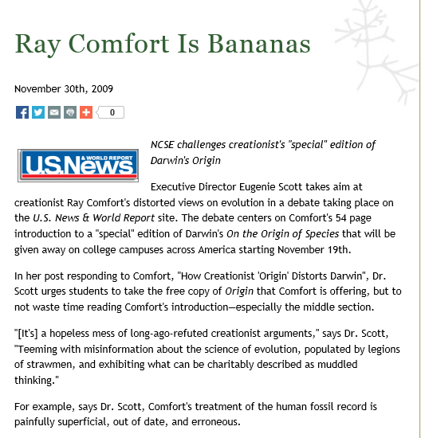
Meet the Press: The Release

Slide 17
Meet the press
The press release
Dueling OpEds
Email, phone, and yes, fax!
Prep the professor

Slide 18
Lessons learned
Humor goes a long way
Shorter is better
Put someone in charge of campaign
Pair scientist/expert with communications staffer

