Slide 1
Building alliances with clergy and religious communities to advocate for science education

Slide 2
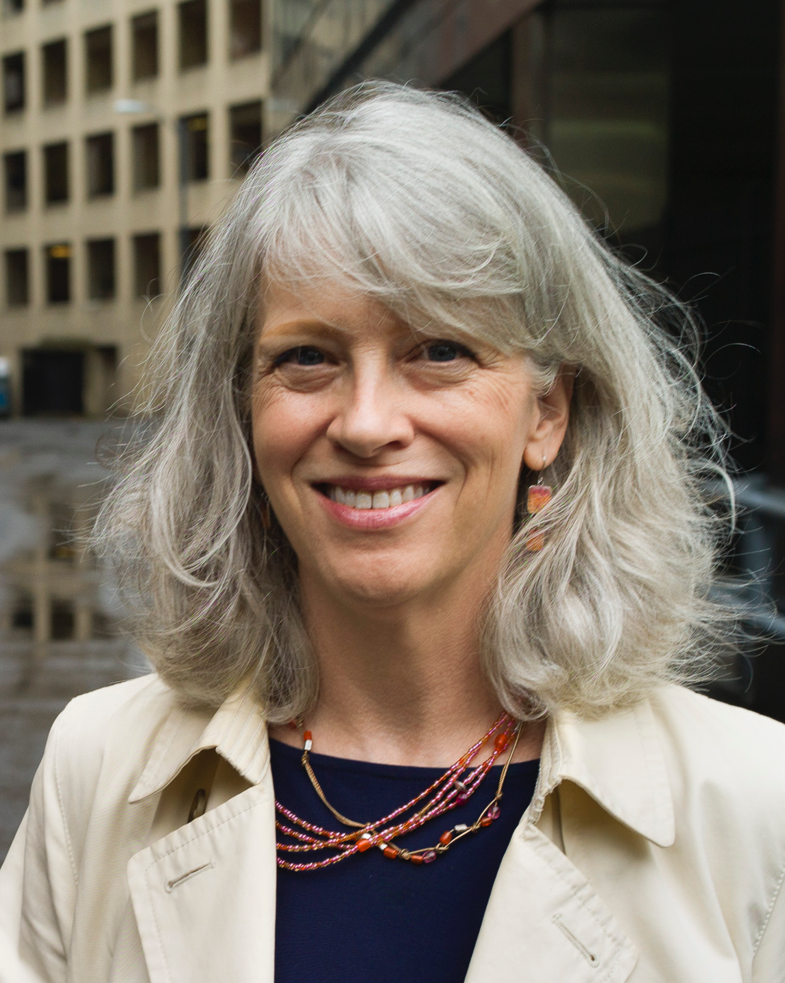
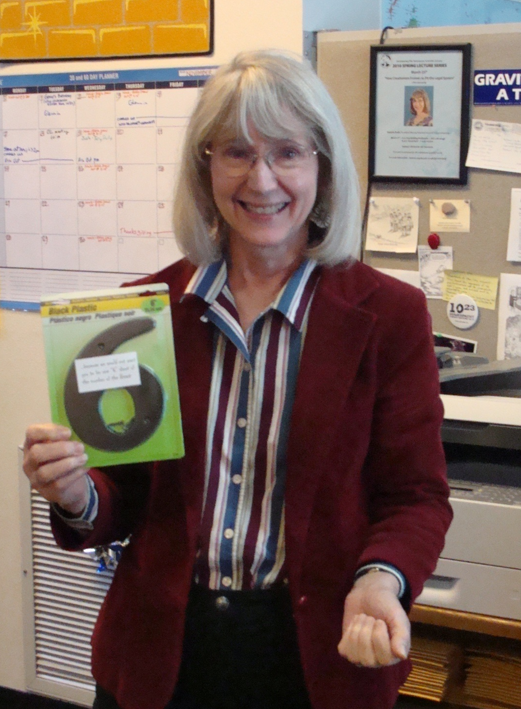
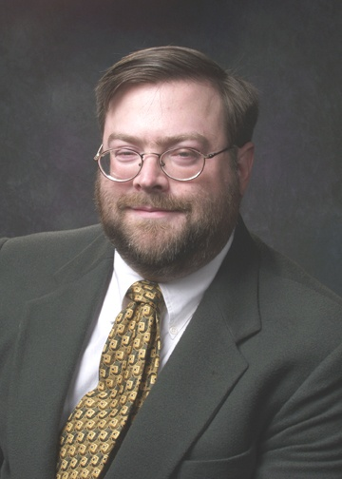
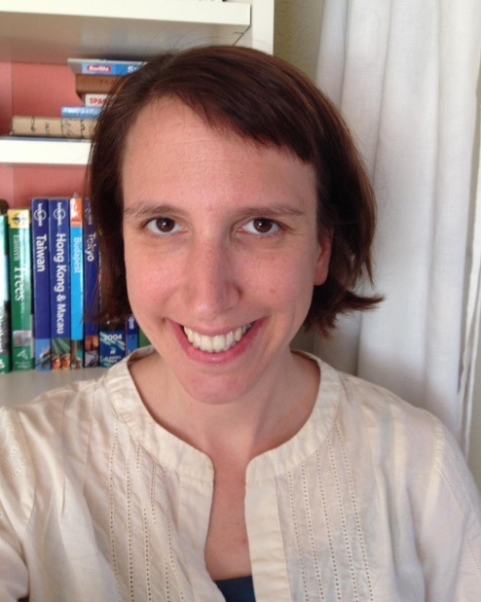
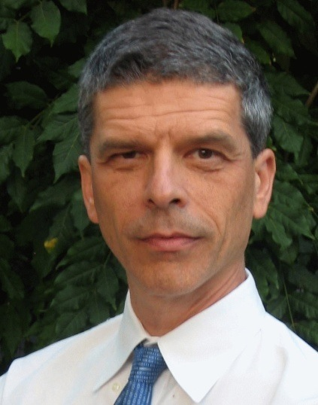
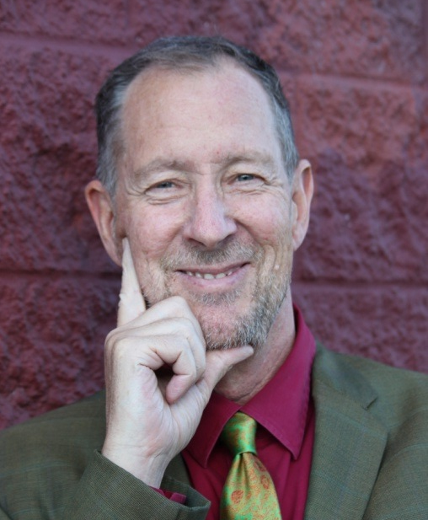
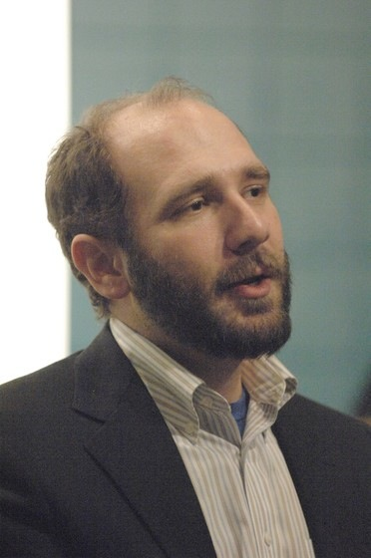
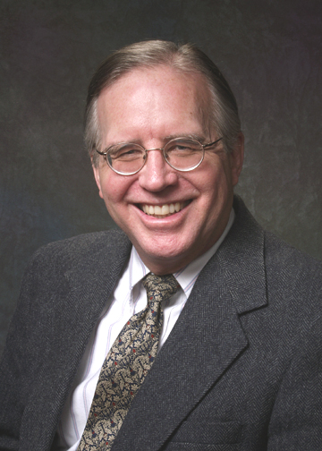
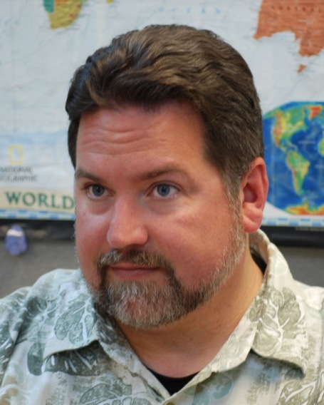
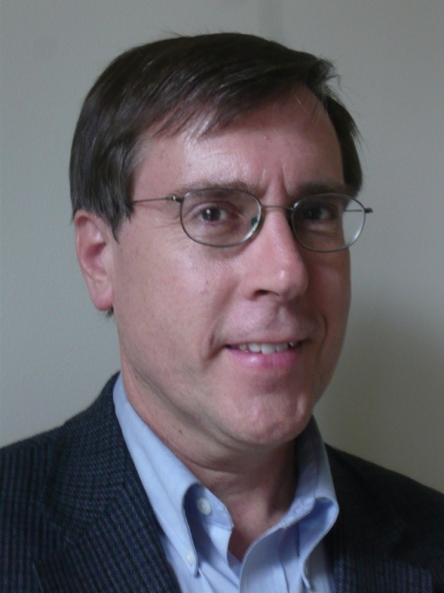
www.NCSE.com
Crisis center
Notes:
Glenn Branch Louise Mead (education), Robert Luhn (Comm); Peter Hess (Faith Outreach),
Flareups wranglers: Josh Rosenau, Steve Newton, Eric Meikle

Slide 3
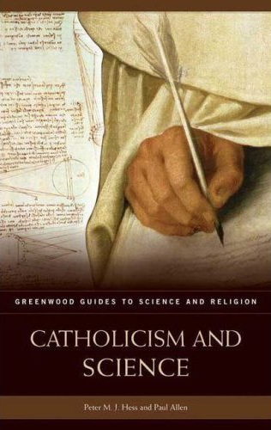
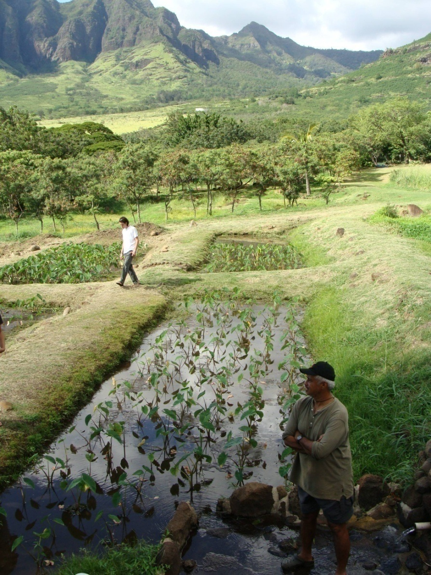
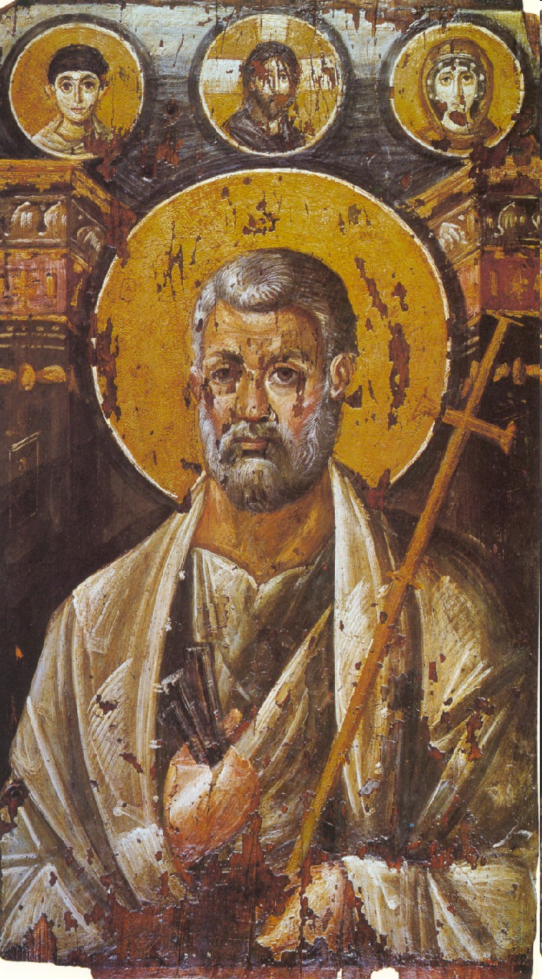
Who am I? What do I do?
Catholic Christian Historical theologian
NCSE Director of Outreach to Religious Communities
Sustainability ethicist
Fellow, International Society for Science and Religion
Author, Catholicism and Science

Slide 4
NCSE: Why do we exist?
To promote and defend the teaching of sound science – evolution and climate change.
To advocate for science in the media, at public and private events, in courtrooms, and in front of conferences, school boards and state legislatures.
Not to take on every dispute, but to empower people in local contexts to take action in defense of science teaching.
Not to launch gratuitous attacks on private belief.
Because life is short, email me: hess@ncse.com.

Slide 5
Science Spectrum
Theistic Evolution
Process Thought
Raelians – other ET
Non-theistic Evolution
Creationism^{I}
Cobb
Gould
Weinberg
Dawkins
CTNS, ISSR, IRAS
ZCRS, IRC, Metanexus
IDC
Discovery Inst.
Theism
Spectrum
Progressive Creation
Hugh Ross
Day Age OEC
Watchtower Society
Gap Theory OEC
Custance
Intersecting Epistemologies:
Evolution, Creation,
and Theistic Belief
© 2007 Peter M. J. Hess
Omphalism
Creationism^{II}
YEC
ICR, AiG, CRI
Geocentrics
Sungenis
Flat Earthers
Notes:
Gould: NOMA ― Non overlapping magisterial authority
Weinberg: “The more the universe seems comprehensible, the more it also seems pointless.”
Dawkins: evangelical atheism

Slide 6
Science & Religion: Models of Interaction Ian Barbour, Religion in an Age of Science (1998)
R
Conflict Model
R
R
R
(S)
S
(R)
S
IndependenceModel

Slide 7
Science & Religion: Models of Interaction Ian Barbour, Religion in an Age of Science (1998)
R
R
R
R
S
S
Integration
Model
Dialogue Model

Slide 8
Science and Religion
Not competing categories
Complementary ways of viewing reality
Each supplies a different perspective on the world
Each should respect the autonomy of the other.

Slide 9
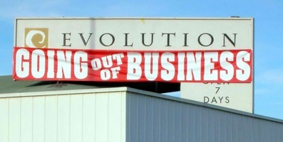
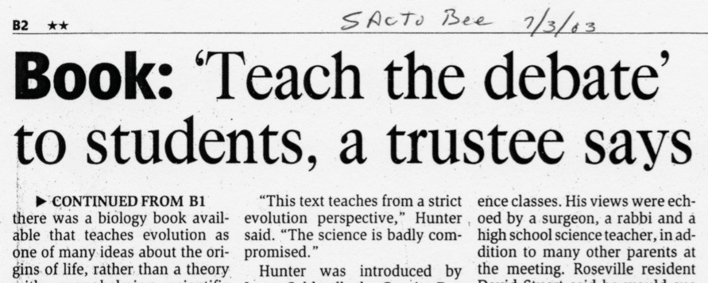
Pillars of Creationism
Evolution is a
“theory in crisis”
Evolution and religion are incompatible
It’s only “fair” to teach creationism with evolution

Slide 10
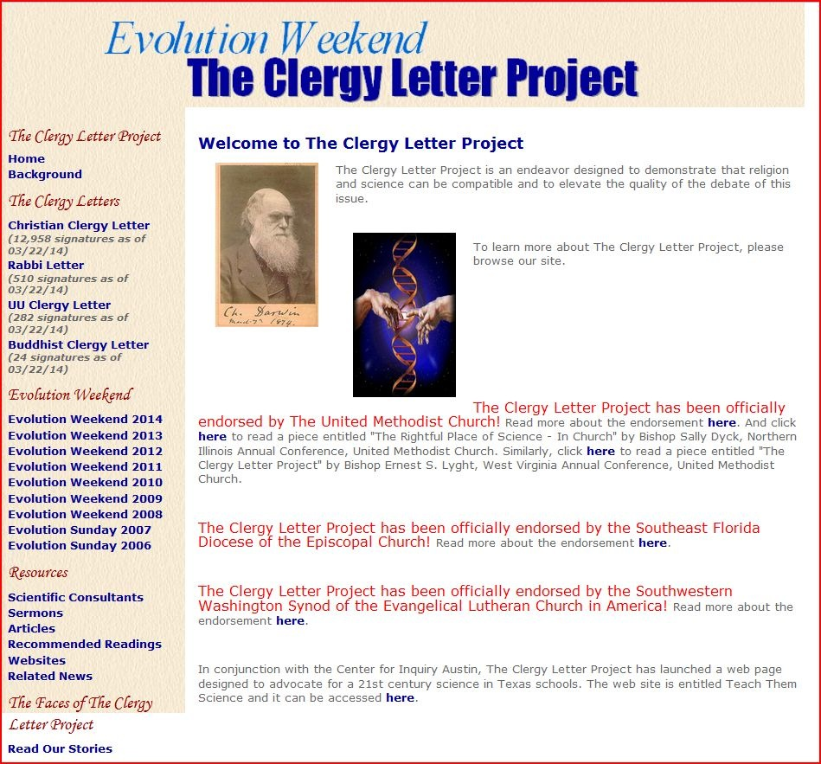
http://www.theclergyletterproject.org/

Slide 11
NCSE Clergy Climate Letter Project —
Draft
Common to all faith traditions is a concern for the human community, for its most vulnerable members, and for the biosphere upon which all animals and plants depend for life. Anthropogenic climate change carries major challenges for every aspect of human existence, virtually all of which have an ethical dimension.
We, the undersigned clergy from many different religious traditions, believe that the scientific consensus about human-caused climate change demands response on the part of religious believers and communities. We believe that members of every faith tradition have the right to know the implications of this consensus, and to act on this knowledge.

Slide 12
Building Coalitions to Meet Crises
Epperson vs. Arkansas (1968): Supreme Court invalidates Arkansas statue prohibiting the teaching of evolution
Edward vs. Aguillard (1987): Supreme Court held Louisiana’s “Creationism Act” unconstitutional, on the grounds that it impermissibly endorses religion
Kitzmiller v. Dover (2005): US District Court Judge Jones orders Dover, PA, school board to refrain from maintaining an “intelligent design” policy

Slide 13
Building Coalitions to Meet Crises
In each case a local crisis becomes magnified to the state level or beyond. We win cases by building coalitions of teachers, parents, clergy, scientists and other parties.
Organizing a coalition
Finding common ground through our diverse backgrounds

