Slide 1
Engaging with the Media The quick version!
Erin Heath
American Association for the Advancement of Science
eheath@aaas.org
NCSE Webinar
February 27, 2014

Slide 2
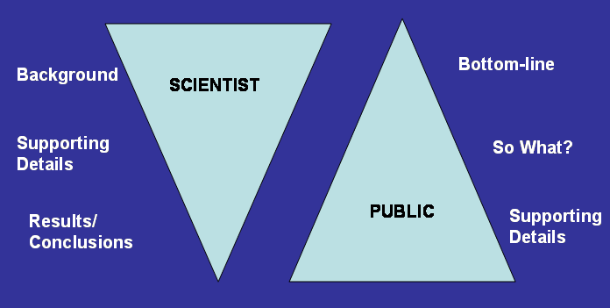
Different styles of communication

Slide 3
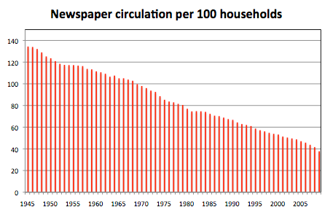
The “post-print” era
Credit: Nieman Journalism Lab, Harvard University

Slide 4
The TV landscape – 1985

Slide 5
The TV landscape – now
…and hundreds more!

Slide 6
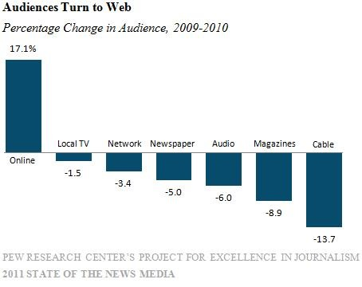

Slide 9
Preparing your message
Audience: “What’s in it for me?”
What’s the bottom line?
Support with facts, examples, stories

Slide 11
“You do not really understand something until you can explain it to your grandmother.” -- Albert Einstein

Slide 12
We need you!
Scientists, engineers, educators and members of the community who can effectively communicate and engage with the public, media, and policymakers on science issues

Slide 13
Identifying opportunities
Colleagues
Campus organizations
Office of University Communications
AAAS online
Communicating Science
Center for Public Engagement with Science and Technology
Engaging Scientists and Engineers in Policy (ESEP) www.aaas.org/esep

Slide 14
Communication resources
www.aaas.org/communicatingscience
Media tips and suggestions from top science reporters
Video from workshops covering topics such as engaging with journalists and utilizing social media
Information about AAAS communicating science workshops
Resource articles, websites, and more!

