Slide 1
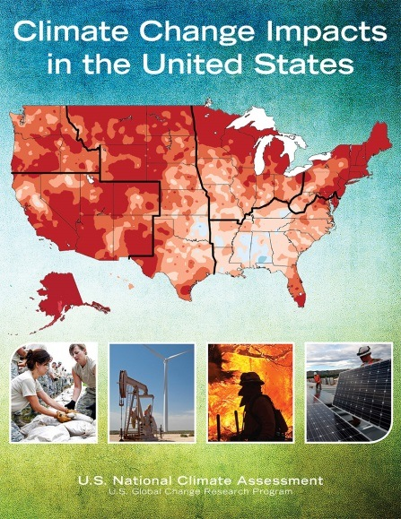
The Third National Climate Assessment
Expected Release: May 6
http://nca2014.globalchange.gov
Notes:
Title slide or “one slide teaser”

Slide 2
Third National Climate Assessment
Conducted under the auspices of the US Global Change Program, in response to requirements of Global Change Research Act of 1990
60 member federal advisory committee
300 authors from public, private, academic, and non-profit sectors
Notes:
Slide two of “three slide teaser”

Slide 3
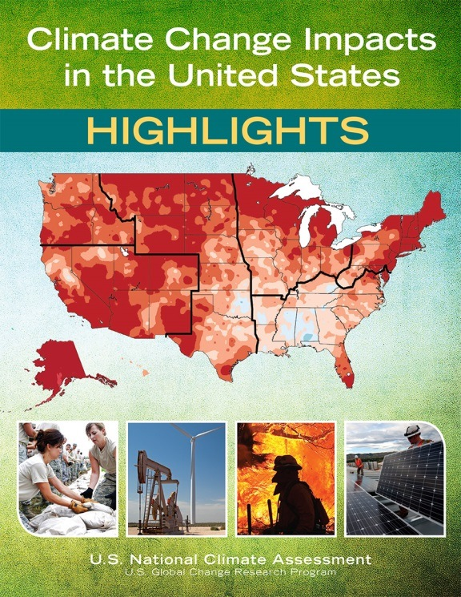
The Report
1300 page report – available online (HTML & PDF) – including links to underlying data, supporting materials, and traceable accounts
120 page highlights – available online (HTML & PDF) and in print
Anticipated Release: May 6, 2014
Find it at http://nca2014.globalchange.gov
Notes:
Slide three of “three slide teaser”

Slide 4
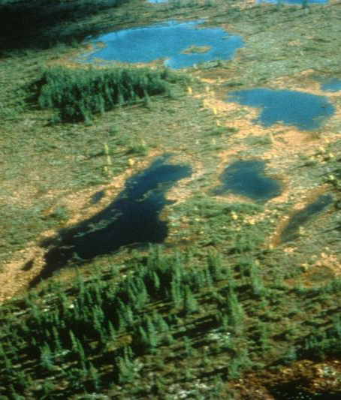
Third National Climate Assessment
Goal
Enhance the ability of the United States to anticipate, mitigate, and adapt to changes in the global environment.
Vision
Advance an inclusive, broad-based, and sustained process for assessing and communicating scientific knowledge of the impacts, risks, and vulnerabilities associated with a changing global climate in support of decision-making across the United States.
Notes:
If providing more info (e.g., vision & report contents), use this slide

Slide 5
Climate Science
Historical climate conditions
Observed changes
Trends
Future climate scenarios
Frequently asked questions
Notes:
If providing more info (e.g., report contents), use this slide

Slide 6
Thirteen Sectors & Sectoral Cross-Cuts
Water Resources
Energy Supply and Use
Transportation
Agriculture
Forests
Ecosystems & Biodiversity
Human Health
Water, Energy, & Land Use
Urban Systems & Infrastructure
Indigenous Peoples, Lands, & Resources
Land Use & Land Cover Change
Rural Communities
Biogeochemical Cycles
Notes:
If providing more info (e.g., report contents), use this slide

Slide 7
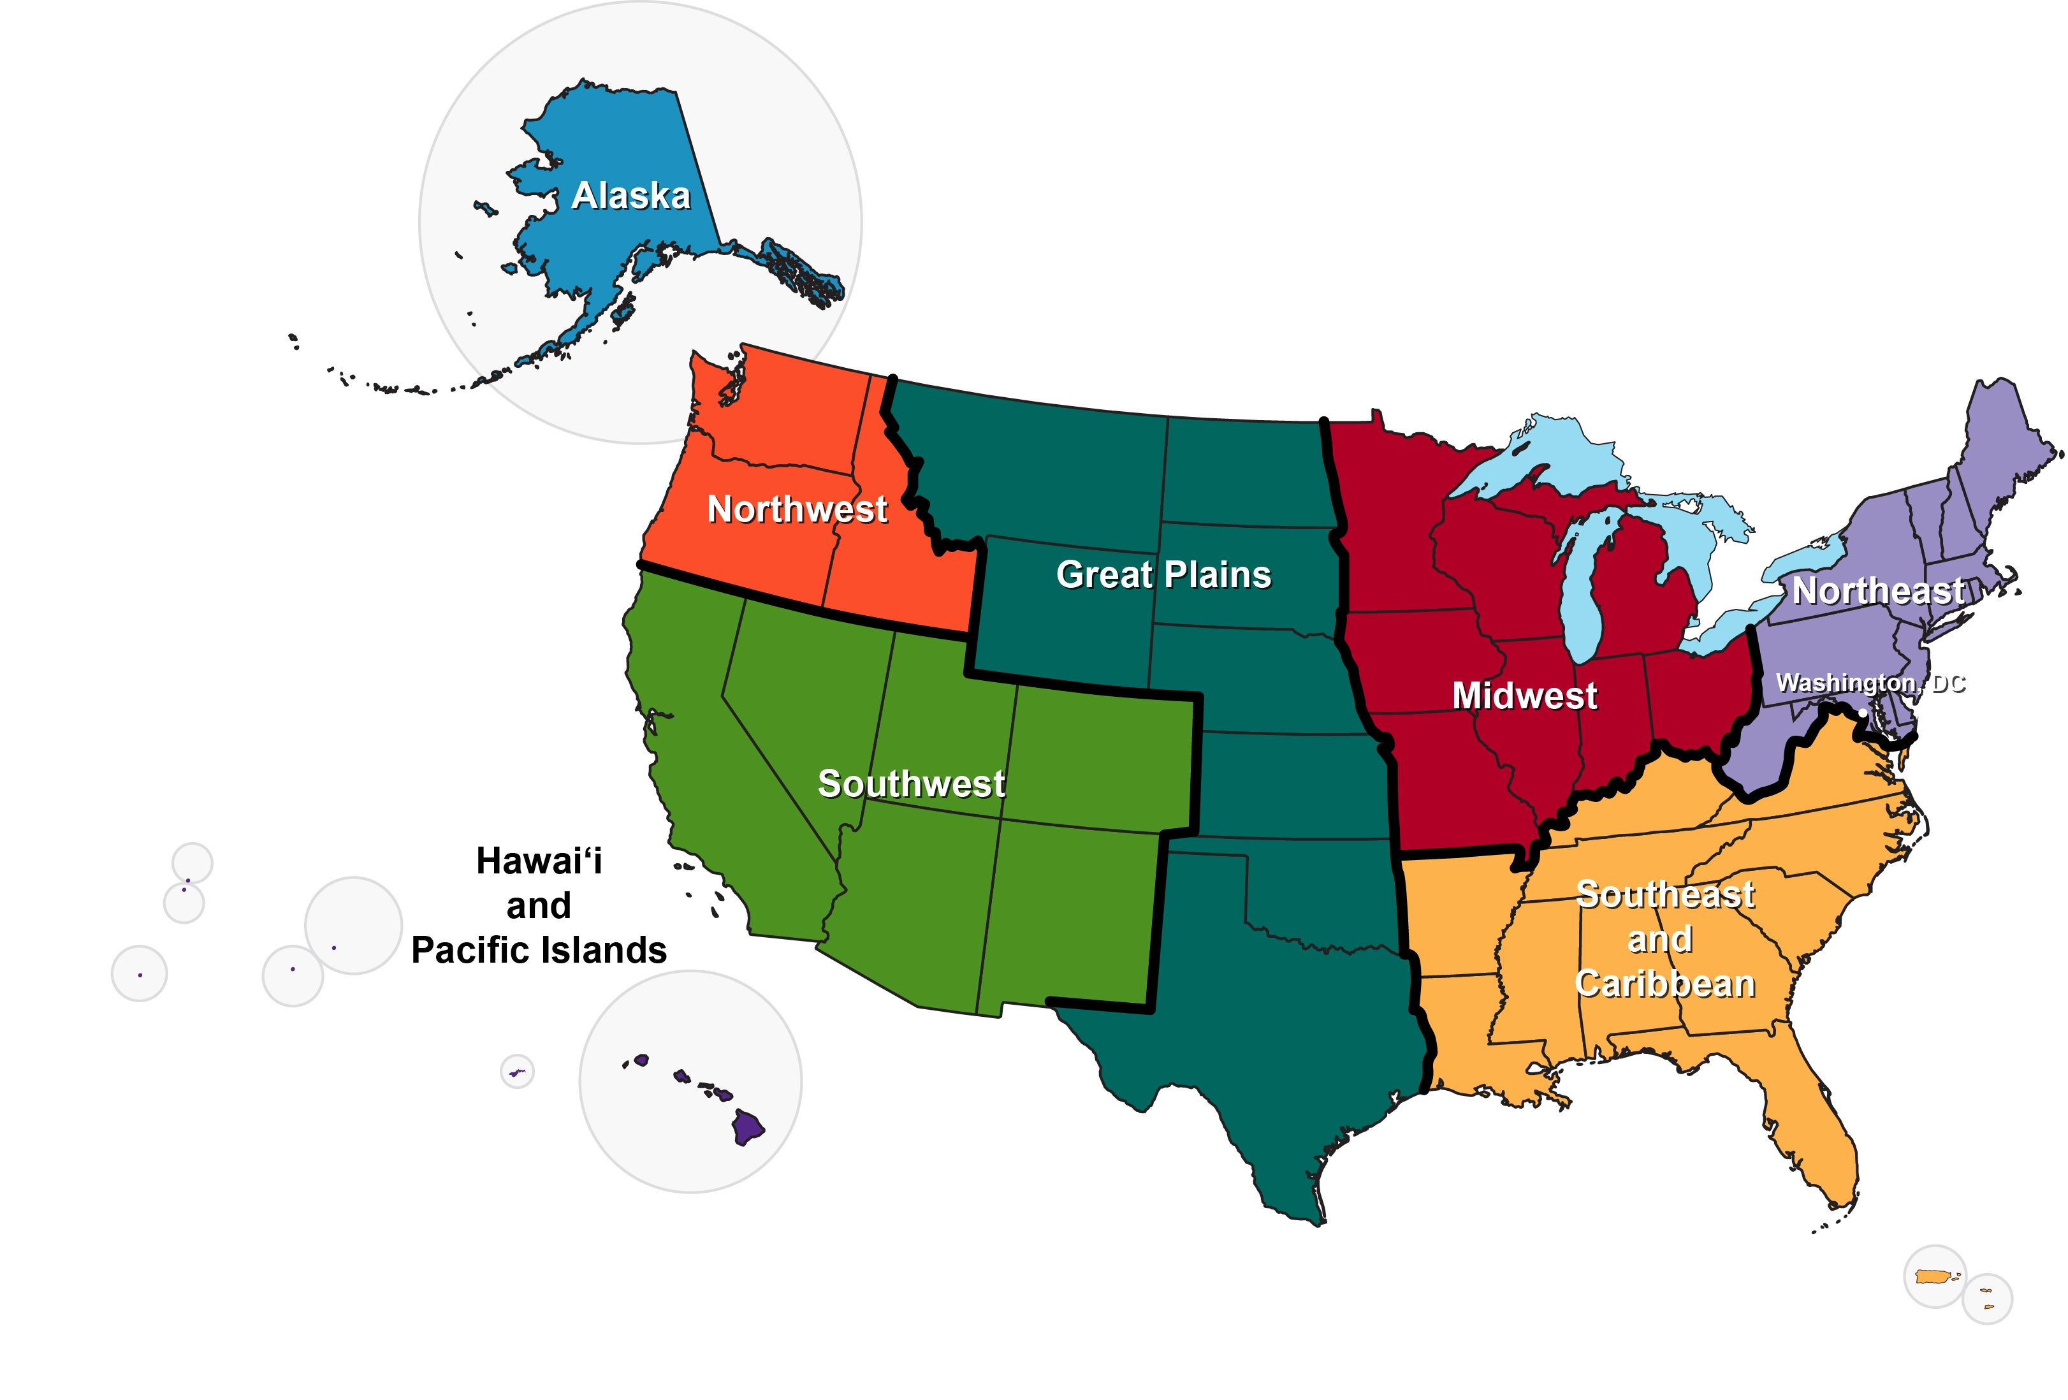
Ten Regions
Oceans
Coasts
Notes:
If providing more info (e.g., report contents), use this slide

Slide 8
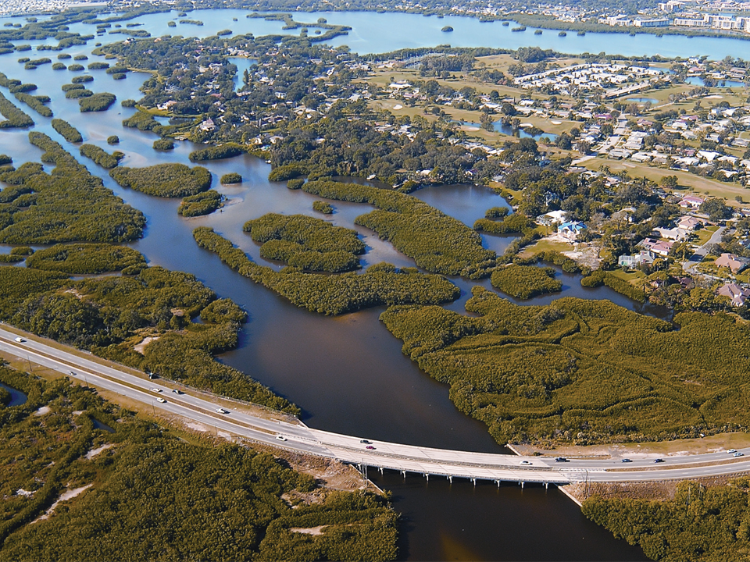
Responses to Climate Change
Decision Support
Mitigation
Adaptation
Research Agenda
Sustained Assessment
Notes:
If providing more info (e.g., report contents), use this slide

Slide 9
The Third National Climate Assessment
Expected Release: May 6
http://nca2014.globalchange.gov
Notes:
End (repeat of slide one)

