Slide 1
The Regeneration Project
The mission is to deepen the connection between ecology and faith

Slide 2
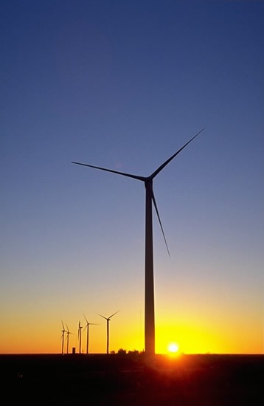
Interfaith Power & Light
Mobilize a religious response to global warming and to promote renewable energy, energy efficiency and conservation

Slide 3
STATE Interfaith Power and Light
The Mission
CIPL seeks to be faithful stewards of God’s Creation
by responding to global warming through the promotion
of energy conservation, energy efficiency, and renewable
energy. This ministry intends to protect the earth’s
ecosystems, safeguard public health, and ensure sufficient
sustainable energy for all.

Slide 4
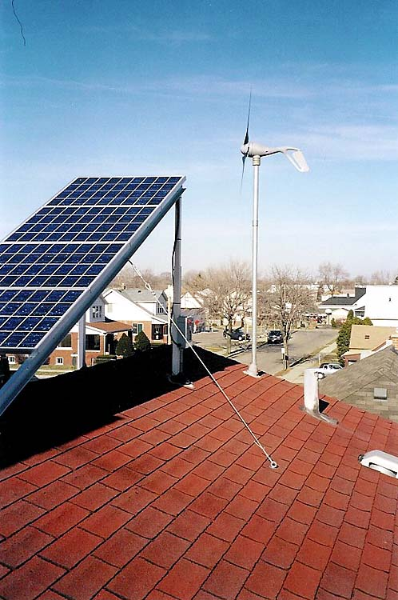
Replace boiler, add solar, wind and solar thermal hot water
Replaced appliances with energy star appliances and got discount through MIPL program

Slide 5
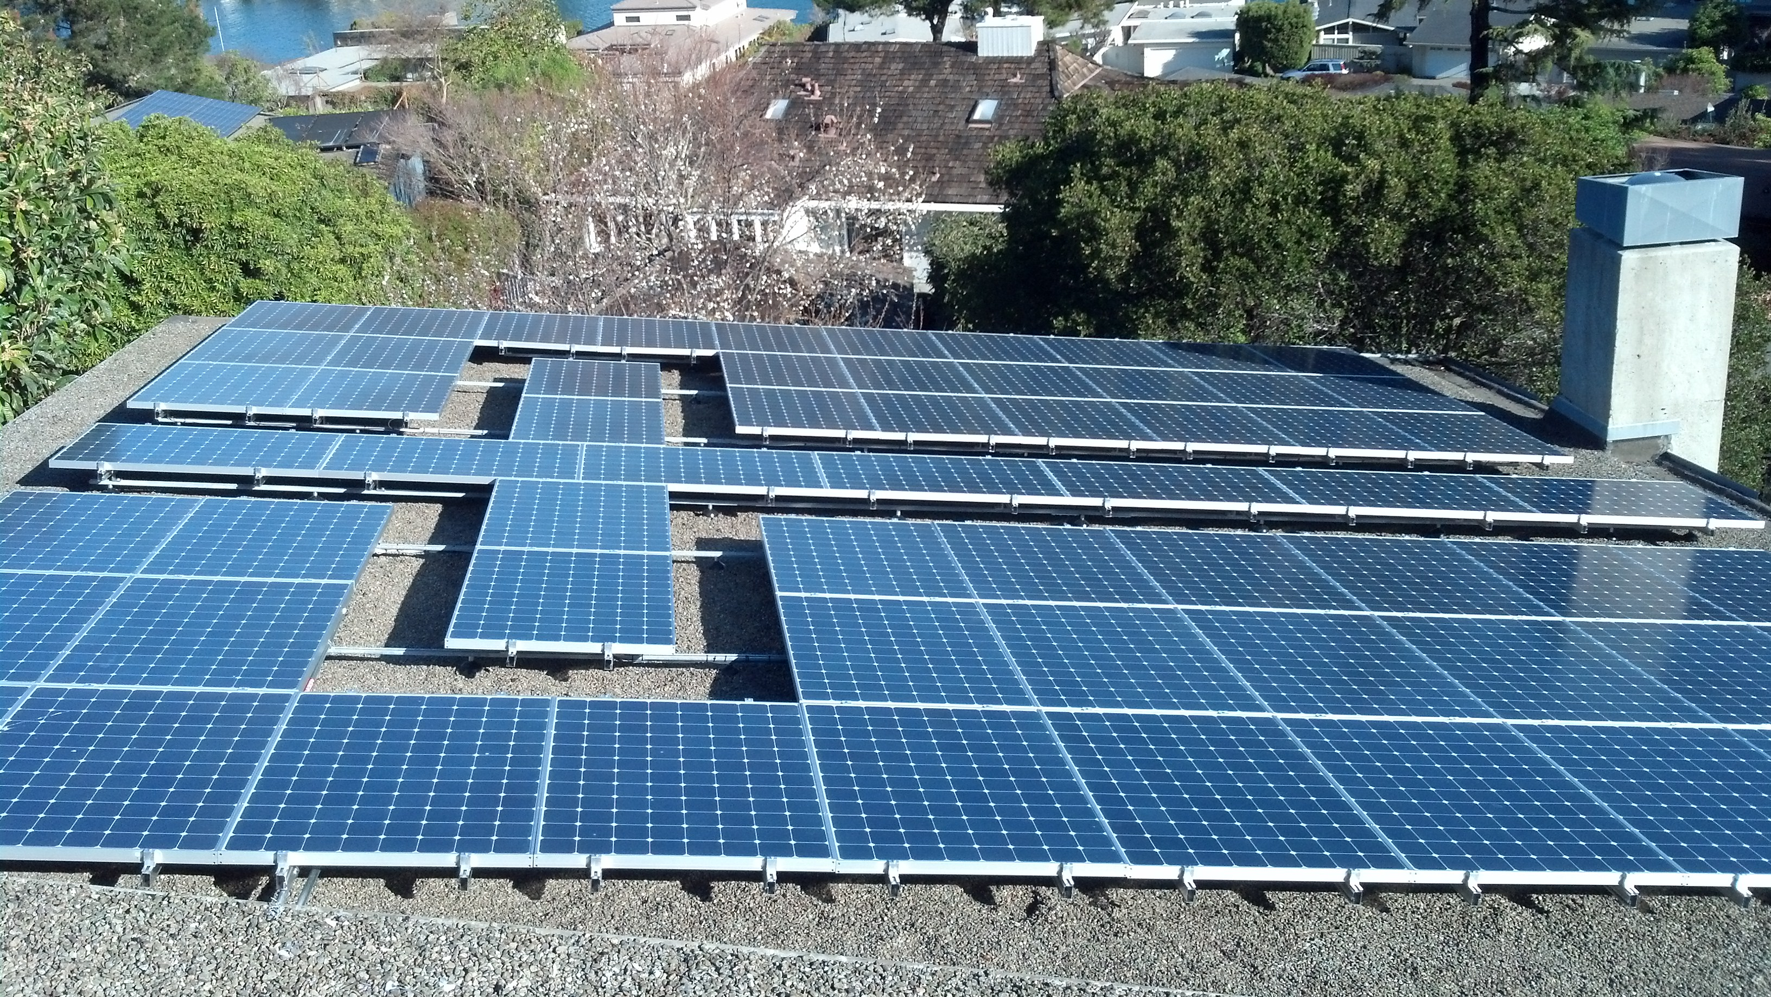

Slide 6
www.theregenerationproject.org www.interfaithpowerandlight.org The Rev. Sally Bingham sally@theregenerationproject.org

