Slide 1
NCSE Clergy Outreach Project Developing a common Lexicon 20 April 2014
Dr. Peter M. J. Hess
National Center for Science Education
Oakland, California

Slide 2
Any conversation about issues at the interface between science and religion is by nature interdisciplinary.
While both the terms “religion” and “science” as we understand them are in fact not all that old, the areas of human thought and action they represent date back thousands of years.
When we begin to dialogue on issues of mutual interest at the interface between science and religion, we often find (not surprisingly) that discussants on either side initially fail to understand their partners’ specialized vocabulary.

Slide 3
In 2009 Peter Hess was asked to serve as consultant for the Convent of the Sacred Heart High School in San Francisco, who in celebration of the Dawin Bicentennial Year were embarking upon“the Darwin Project,” a year of teaching about evolution across the curriculum
He found that in the initial planning stages the science faculty and the religion faculty were frequently talking past each other.
Theologians did not readily understand what was meant by “theory” “fact” or “law,” while scientists were challenged by unfamiliar terms such as “theodicy,” “eschatology,” or “theological anthropology.”

Slide 4
In the interest of cutting through various knots of interdisciplinary misunderstanding, Hess proposed that the faculty arrange an afternoon of dialogue about drawing up a common lexicon.
He drew up a preliminary list of terms employed by practitioners and teachers of science, and by theologians and teachers of religious studies.
The faculty discussed the matter of why each group used a specialized vocabulary and then reviewed and refined the list of terms and their definitions.
What resulted was the common lexicon for Sacred Heart’s “Darwin Project,” a tool that was referred to by faculty and students alike throughout the year whenever problems arose in interdisciplinary dialogue.

Slide 5
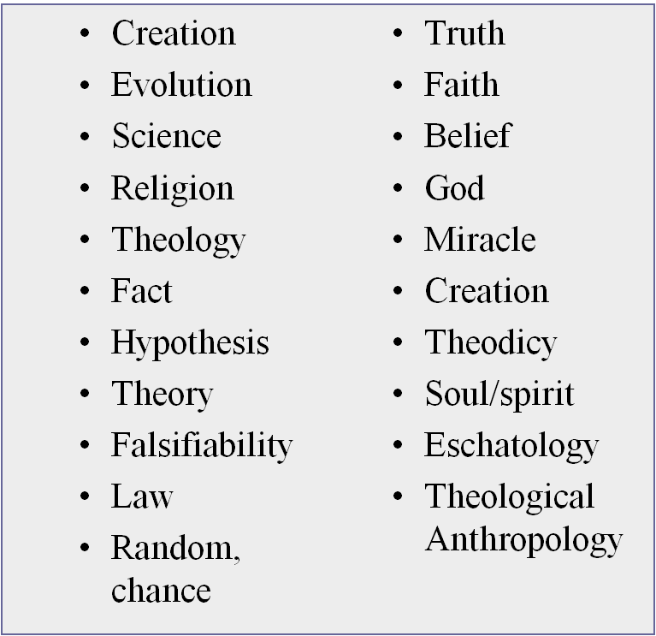
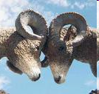
Resources: Developing a Common Lexicon
Terms in need of definition:
Are we destined forever to butt heads, or can we find some definitional common ground?

Slide 6
Science: the Latin word “scientia” originally meant knowledge or practical understanding, and was contrasted with “sapientia” or wisdom (“sophia” in Greek). In the middle Ages the subject matter of science would have been anything that can be organized and studied systematically, including theology, the “queen of the sciences.” The umbrella of “natural history” included the study of animals and plants, rocks, minerals, and other curiosities; that of “natural philosophy” included such subjects as astronomy, motion, cosmology, and meteorology.
As the pace of philosophy quickened in the later Middle Ages, and Copernicus’ resuscitation of the heliocentric hypothesis stimulated the exploration of diverse ideas in natural philosophy, including the atomic theory of matter, the existence of a vacuum, and the circulation of the blood. In the seventeenth century, the “New Philosophy”―in contrast to the received tradition of Aristotelianism―came to designate the approaches and disciplines arising during the “scientific revolution.”
Isaac Newton published his comprehensive new theory of astronomical motion as Philosophiae Naturalis Principia Mathematica (Mathematical Principles of Natural Philosophy). More broadly, his subject was, of course, what today we would call physics. Likewise, alchemy would develop into chemistry proper in the next century. Geology would gain professional respectability, and biology, paleontology and allied sciences would branch from natural history. The term “scientist” was first employed in 1834 by William Whewell to designate a practitioner of one of these new divisions of knowledge.

Slide 7
“Creation” and “Evolution”
Developing a Common Lexicon
“Creation” is a metaphysical claim: the universe depends for its existence upon something or some being outside itself. “Creation” makes no claim about how or when the world came to be, or even whether creation was an event or an “act” in time. It is compatible with monotheistic religions.
“Evolution” is a biological theory that all life is related through “descent with modification.” It is testable, is well , and properly interpreted makes no claims about God’s existence or non-existence. Evolution is compatible with theism (belief in God), atheism (disbelief in God), and agnosticism (not being sure).

Slide 8
Developing a Common Lexicon
“Fact,” “theory,” “law”
Fact: an observation that has been repeatedly confirmed and for all practical purposes is accepted as “true.”
Theory: a well-substantiated explanation of an aspect of the natural world that can incorporate facts, laws, inferences, and tested hypotheses.
Law: a descriptive generalization about how an aspect of the natural world behaves under stated conditions

Slide 9
Developing a Common Lexicon
“Truth”
Philosophers have argued over truth since Socrates and Pontius Pilate posed the question. Theories about the relationship between claims and reality include
“correspondence, coherence, conformity, congruence, agreement, accordance, copying, picturing, signification, representation, reference, satisfaction) and/or various concepts for the relevant portion of reality (facts, states of affairs, situations, events, objects, sequences of objects, sets, properties, tropes.”
(Stanford Encyclopedia of Philosophy, 2005)

Slide 10
Theodicy:
Theos (Θεός) = God
Dike (δικαιοσύνης) = justice
“Justifying the belief in God despite suffering and evil”
Central problem: can I believe in a good, omnipotent, and omniscient God in the face of evolutionary evil?

Slide 11
Eschatology: branch of theology concerned with what are believed to be the “end time,” the final events of history, the ultimate destiny of humanity.
The word arises from the Greek ἔσκατος/ ἔσκάτη/ ἔσκατον, eschatos/eschate/eschaton meaning “last” and -logy meaning “the study of,” first used in English around 1550. Eschatology traditionally deals with the “four last things”: death, judgment, heaven and hell.
Scientists should know that many theologians are well aware of the challenges of dealing with this topic in light of an ancient, dynamic, and evolving universe.

Slide 12
Theological Anthropology:
The study of the human person in conversation with the doctrinal framework of particular religious traditions. Typically TA studies the human as it relates to God. It differs from the social science of anthropology, which deals with the comparative study of the physical and social characteristics of humanity across times and places.
Another aspect of TA studies the innate nature or constitution of the human, known as the nature of humankind. It is concerned with the relationship between notions such as body, soul and spirit which together form a person, based on their descriptions in the Bible. Three traditional views of the human constitution are trichotomism, dichotomism and monism.

Slide 13
Developing a Common Lexicon
“Truth”
Truth in Science: particular “truths” are never final; what is accepted as a truth today may be modified or even discarded tomorrow. However, truth is an asymptote toward which science strives; in that sense scientific truth is unchanging.
Truth in religion has a different quality: divine truth is always mediated by the believing community, by its rituals and prayers, by its scriptures written in particular contexts. “Truth as doctrine” is only one theological model, which should be measured against the person and life of Jesus as “the way, the truth, and the life.” Gospel of John, 14:6.

Slide 14
Non-reductive Physicalism:
An anti-dualist perspective: the person is what we see – psycho-somatic unity. Higher levels of complexity and organization emerge from and are not reducible to lower levels.
Nancey Murphy and Warren Brown, eds. Whatever Happened to the Soul? Scientific and Theological Portraits of Human Nature (Augsburg-Fortress Press, 1998)

Slide 15
Emergentism
The Universe emerges from pre-Big Bang initial conditions
Matter emerges from energy of the Big Bang
Life emerges from energy and matter
Mind emerges from life
Spirit emerges from mind
Philip Clayton and Paul Davies, eds. The re-emergence of emergence: the emergentist hypothesis from science to religion. Oxford University Press, 2006

Slide 16
Evolutionary and Emergent Non-reductive Physicalism
A theology in which God works in, with, and through creation can conceive of the soul as being transmitted integrally through the evolution of human physical nature and its increasing neural endowment.
This is consistent with a Hebraic understanding of the person as a psychosomatic unity, and addresses a number of important theological problems:

Slide 17
Developing a Common Lexicon
“Faith
Religion: In Christian thought, “Faith is the assurance of things hoped for, the conviction of things not seen," Hebrews 11:1. Faith is central to any religious tradition, for without it, scriptures are ordinary literature, and rituals empty of transcendental meaning.
Science: Faith plays a different but equally significant and often unappreciated role in scientific practice. Science is not merely a matter of testing hypotheses against observations. A key element is faith on the part of the scientist that the world is in fact knowable, comprehensible, a project worth pursuing.

Slide 18
Models of Interaction between S&R drawn from Ian Barbour, Religion in an Age of Science (1998)
R
Conflict Model
R
R
R
(S)
S
(R)
S
IndependenceModel

Slide 19
Models of Interaction between S&R drawn from Ian Barbour, Religion in an Age of Science
R
R
R
R
S
S
Integration
Model
Dialogue Model

Slide 20
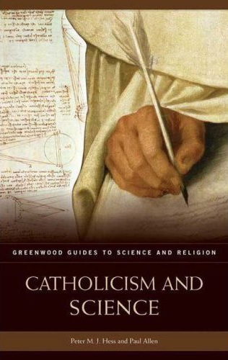
Resources: Books
Chapter 3
“From the Garden of Eden to an Ancient Earth: the Catholic Reception of Evolution”

Slide 21
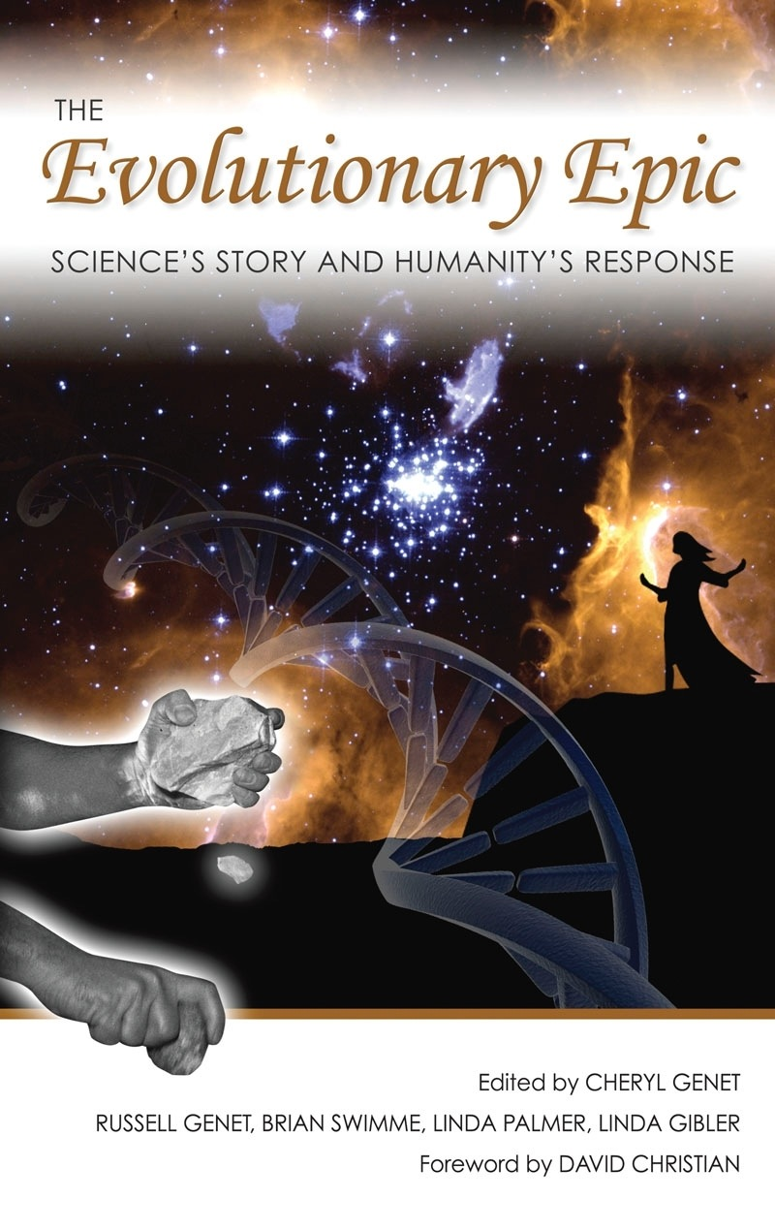
The Evolutionary Epic Chapter 33: “Theological Problems and Promises of an Evolutionary Paradigm” Peter M. J. Hess

Slide 22
Resources: Websites
University of California Museum of Paleontology (UCMP)
http://www.ucmp.berkeley.edu/index.php
Talk Origins: http://www.talkorigins.org/origins/welcome.html
Mainstream scientific responses to frequently asked questions (FAQs) about intelligent design or other creationist pseudosciences.

Slide 23
Resources: Websites
The American Scientific Affiliation: http://www.asa3.org/
Christians working in science.
The Clergy Letter Project: http://www.butler.edu/clergyproject/Christian_Clergy/ChrClergyLtr.htm
Organized by Michael Zimmerman. Over 12,000 rabbis and Christian clergy have signed a strong pro-evolution-education statement.

Slide 24
Resources, continued
The Great Story: http://www.thegreatstory.org/
Michael Dowd, UCC pastor, and science writer Connie Barlow (married team) tell the 14 billion year science-based sacred story of cosmic genesis.
Interdisciplinary Encyclopedia: http://www.disf.org/en/default.asp

Slide 25
Is “gravity” a fact or a theory?

Slide 26
What is happening here?
We see only a snapshot, so maybe they are stationary in the air
Two skydivers are in free fall
Heavy objects are seeking their natural “place” -- earth (Aristotle)
God is willing their fall through the air (theistic voluntarism)
Gravity is pulling them down against air resistance (Newton)

Slide 27
What is happening here?
Scientific theory:
Two skydivers are being pulled toward the earth by a force proportional to the product of their masses and inversely proportional to the square of the distance between their centers (Newton’s Law), slowed by air resistance.
So -- is “gravity” a fact, or a theory?

